Slide 3
The Greatest Day of History will ALWAYS be the Cross. After all history is His-Story!

Slide 6
What to expect throughout the lecture?
Please look at my slides for information on supporting exhibits.
Supporting exhibits will be on the table. Take pictures of the exhibits. Purchase them for yourself. I don’t loan these out!
Don’t take my word for it – research for yourself.
Hoping to finish the lecture in a timely manner and open up the session for Q and A and comments.
Explain the packets.
I would love to try to come to your church or small group and share this info and I would love for you to share this information with those in your sphere of influence.

Slide 7
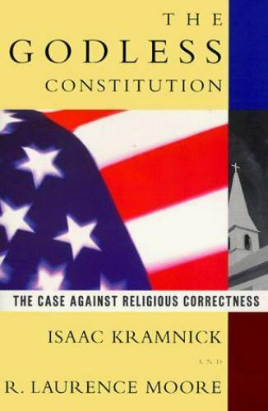
What has happened to American History?
This book is being taught as fact.
Can you imagine a that is half inch thick w/o a proper bibliography being taught as fact?

Slide 8
The Black Robed Regiment
How many know who the Black Robed Regiment were?
Can you name any?
Jonas Clark
Samuel Davies
Peter August Muhlenberg
Frederick Muhlenberg
You can go to my website today under the lecture “The Shot Heard Around the World” and download “A Vindication of the Government of the New England Churches” by Reverend John Wise

Slide 10
Did you know the Declaration of Independence lists the Deity of God four times?

Slide 11
The Declaration of Independence
-When in the Course of human events, it becomes necessary for one people to dissolve the political bands which have connected them with another, and to assume among the powers of the earth, the separate and equal station to which the Laws of Nature and of Nature’s God entitle them, a decent respect to the opinions of mankind requires that they should declare the causes which impel them to the separation.

Slide 12
The Declaration of Independence
-We hold these truths to be self-evident, that all men are created equal, that they are endowed by their Creator with certain unalienable Rights, that among these are Life, Liberty and the pursuit of Happiness.

Slide 13
The Declaration of Independence
-We, therefore, the Representatives of the United States of America, in General Congress Assembled, appealing to the Supreme Judge of the world for the rectitude of our intentions, do, in the Name, and by the Authority of the good People of these Colonies, solemnly publish and declare, That these United Colonies are, and of Right ought to be Free and Independent States;

Slide 14
The Declaration of Independence
-And for the support of this Declaration, with a firm reliance on the protection of divine Providence, we mutually pledge to each other our Lives, our Fortunes, and our sacred Honor”

Slide 15
…Every State of the US mentions God…
Every State mentions an attribute of God in their preamble or Constitution
Montana Constitution Preamble:
“We the people of Montana grateful to God for the quiet beauty of our state, the grandeur of our mountains, the vastness of our rolling plains, and desiring to improve the quality of life, equality of opportunity and to secure the blessings of liberty for this and future generations do ordain and establish this constitution.”

Slide 16
The History of God in America - Know Your Rights
Did you know when Christians stand up for their rights in a Court of Law in America, Christians win!
Why?
Because our Christian principles have been so imbedded in our society
Bladensburg Case
The recent victories with SCOTUS (overturning NY gun bill, Roe V. Wade, and Coach Kennedy)

Slide 17
Let’s talk about the recent SCOTUS rulings 2022.

Slide 18
Understanding the heart of God – He is a God of order I.E. Immigration
Immigration from a Biblical Viewpoint. God is a God of borders as each tribe of Israel got specific boundaries. God also permitted foreigners to live amongst the land, but the foreigners had to obey certain laws of the land. God also had rules on how Israel was to treat the foreigner. Immigration does need to be looked at from a Biblical, historical and constitutional perspective!
Historically speaking folks used to have to live in America for FIVE years before being permitted citizenship to ensure they wouldn't bring bad philosophy in from their country and would live the American way!
We as citizens need to ensure folks coming in and wanting to be citizens are not going to go against our constitution and our way of life!
My Exhibit: The Holy Bible – Old Testament – read it for yourself

Slide 19
Where did the idea of Life, Liberty and Pursuit of Happiness come from?
Did you know that life, liberty and pursuit of happiness (translated as property) came from the Bible?
The Adamic Covenant (Life, Liberty and Pursuit of Happiness is actually extended in the Noahic Covenant)
Genesis 1:28, NASB: God blessed them; and God said to them, “Be fruitful and multiply, and fill the earth, and subdue it; and rule over the fish of the sea and over the birds of the sky and over every living thing that moves on the earth.”
"Be fruitful, and multiply" - which is mankind's basic right to life.

Slide 20
Where did the idea of Life, Liberty and Pursuit of Happiness come from?
The Hebrew word, fill or replenish, involves the scientific method breaking down something from one form to another form. The concept that requires the right of liberty.
"Subdue the earth" - Have dominion. One's right to have a parcel of land and be a good steward before God.
Also see “Exhibit T: The DOI and Constitution Linked Plymouth Rock” from my website under The Influence of the Bible in America.
Also see: www.plymrock.org/the-declaration-and-the-constitution-inseperable/

Slide 21
Where did the idea of protecting your life come from? AKA The Castle Doctrine
The right to bear arms - unalienable right, original intent of our Founding Fathers and from the Bible.
Exodus 22:2 (NASB): If the thief is caught while breaking in and is struck so that he dies, there will be no blood guiltiness on his account.
James Wilson, signer of both the Constitution and the Declaration of Independence and original Justice to the Supreme Court of the United States declared:

Slide 22
Where did the idea of protecting your life come from? AKA The Castle Doctrine
Homicide is enjoined [required] when it is necessary for the defense of one's person or house.... [E]very man's house is deemed, by the law, to be his castle; and the law, while it invests him with the power, [places] on him the duty of the commanding officer [of his house]. "Every man's house is his castle ... and if anyone be robbed in it, it shall be esteemed his own default and negligence."
“Castle Doctrine” – if you were robbed in your own house, it was not police’s fault, but yours as God made you the commander of your “castle”.
See Exhibit A The Bible and Self Defense
Search online for The Laws of England by Blackstone

Slide 23
How can I be pro-life and pro-Capital Punishment?
Concerning the death penalty, the Bible says: “Whoever is deserving of death shall be put to death on the testimony of two or three witnesses; he shall not be put to death on the testimony of one witness.” (Deuteronomy 17:6, NKJV)
Concerning treason (a death penalty offense specifically named in the Constitution), the Constitution likewise requires: “No person shall be convicted of treason [and put to death], unless on the testimony of two witnesses to the same overt act” (Article, Section 3, Paragraph 3).
See “Exhibit D: The American Founding and the Federal Era (1785-early-1800s)” from my lecture of The Influence of the Bible in America

Slide 24
Ceremonial Law, Moral Law, Social Compact Law and Judicial Law
Why so much law?
First we must understand law is made for the lawbreaker. 1 Timothy 1:8-10
We cannot separate God from anything. God is part of all our lives, including Government and Law.
Law is for all of time and for all nations.
Law brings liberty when followed because we have proper guardrails in our homes,
lives, community and nation.

Slide 25
Ceremonial Law, Moral Law, Social Compact Law and Judicial Law
Ceremonial Law
The ceremonial law is a law of types and shadows of things to come which all pointed to Christ and were finished at the Cross.
DON’T CONFUSE CEREMONIAL LAW AND THE TEN COMMANDMENTS

Slide 26
Ceremonial Law, Moral Law, Social Compact Law and Judicial Law
Moral Law (essentially tells us what is right and wrong and never changes)
The Ten Commandments are God’s Moral Law. Moral Law you don’t cross. Blackstone actually got our common law (laws of nature and nature’s God) from The Ten Commandments.
There are also moral laws found in the Bible we don’t cross (marriage being one example).
One cannot vote on Moral Law.
The 7th Amendment goes in great deal of common law.

Slide 27
Ceremonial Law, Moral Law, Social Compact Law and Judicial Law
Judicial Law
This law can change from nation to nation. Judges in Australia will act differently than in America. Judicial law can change!
-Judges used to give salvation messages from the bench
-Judges used to be removed for public drunkenness
-In order for a nation to be right again, a seed must be planted with our judges: --Isaiah 1:26:
“Then I will restore your judges as at the first, And your counselors as at the beginning; After that you will be called the city of righteousness, A faithful city.”
I encourage all folks to Read Federalist # 78

Slide 28
Ceremonial Law, Moral Law, Social Compact Law and Judicial Law
Social Compact Law
This type of law falls under moral law and where the will of the majority wins.
The Bible instructs on other laws. For example, bestiality or rape, or marrying first cousins or a sister (these aren’t necessarily found in the Ten Commandments, but are still are moral laws).
Social Compact Law creates an orderly society. For example, lets say I don’t like how your lawn is mowed. Do I have the right go over on your property and mow y
your lawn to my standard? No!

Slide 29
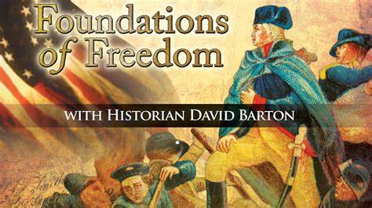
Ceremonial Law, Moral Law, Social Compact Law and Judicial Law
How can we fix some of our law?
Christians need to get back to having a Biblical Worldview and believing in ONE MORAL TRUTH.
For more information on these laws and how the Bible influenced America, I recommend my lecture “The Influence of the Bible in America” and Foundations of Freedom by David Barton.

Slide 32
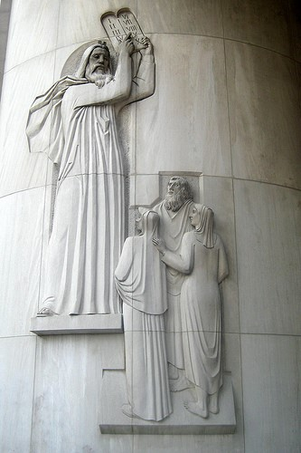
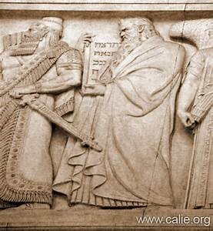
The Ten Commandments
ON THE LEFT;
The Ten Commandments pictured at the US Supreme Court.
ON THE RIGHT:
Moses giving the Israelites the Ten Commandments New York Supreme Court.

Slide 33
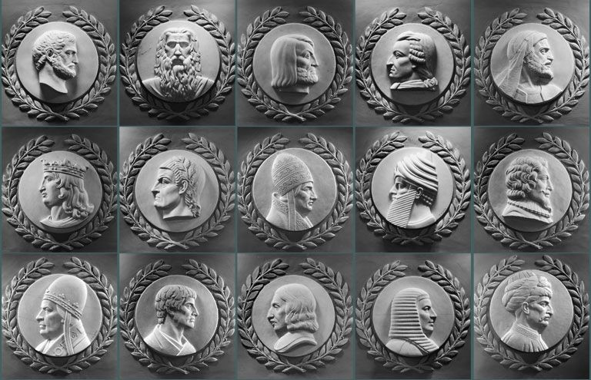
Many great lawgivers throughout time are shown here; however, Moses is the only one facing the Speaker of the House in the rotunda in our nation’s capitol.

Slide 34
Our Constitution Actually Obeys The Sabbath
Sundays Excepted Clause
The US Constitution, 1787, Article 1, Section 7, the President has ten days to sign a law, “Sundays excepted”
Article 1 - The Legislative Branch Section 7 - Revenue Bills, Legislative Process, Presidential Veto
“…If any Bill shall not be returned by the President within ten Days (Sundays excepted) after it shall have been presented to him…”

Slide 35
The Ten Commandments in American History
Honor the Sabbath
During the American Revolution, the Commander in Chief, George Washington ordered the Sabbath be observed: “The Commander in Chief directs that Divine service be performed every Sunday at 11 o’clock … it is expected that officers of all ranks will be their attendance set an example to their men.”
Following the Revolution, the states continued to Honor the Sabbath:
-Vermont, 10 part Sabbath Law, 1787 -Massachusetts, 11 part Sabbath Law, 1794 -Virginia, 8 part Law, written by Thomas Jefferson, 1792 -New Jersey, 21 part Sabbath Law, 1798 -New Hampshire, 14 part Sabbath Law, 1799 -Maine, 13 part Sabbath Law, 1821

Slide 36
The Ten Commandments in American History
Have No Other Gods
-First incorporated into the first written code of laws in America, Virginia Colony 1610, and Massachusetts of 1641, Connecticut 1642.
-If any man after legal conviction shall have or worship any other god but the Lord God, he shall be put to death. Deut. 13:6 & 10; 17:2 & 6; Ex. 22:20.
Have No Idols
-1680 law of New Hampshire.
-It is enacted by ye Assembly and ye authority thereof, yet if any person having had the knowledge of the true God openly and manifestly have or worship any other god but the Lord god, he shall be put to death. Ex: 22:20, Deut. 13:6, 10.

Slide 37
The Ten Commandments in American History
Do Not Murder
Massachusetts, 1641.
“Ex. 21:12, Numbers 35:13,14,30,31. If any person commit any willful murder, which is manslaughter committed upon premeditated malice, hatred, or cruelty not in a man’s necessary and just defense, not by mere casualty against his will, he shall be put to death. Ex. 21:14. If any person shall slay another through guile, either by poisoning or other such devilish practice, he shall be put to death.”

Slide 38
The Ten Commandments in American History
Honor Your Parents
Connecticut, 1642.
“If any child or children above sixteen years old and of sufficient understanding shall curse or smite their normal father or mother; he or they shall be put to death unless it can be sufficiently testified that the parents have been very unchristianly negligent in the education of children, or so provoke them by extreme and cruel correction that they have been forced thereunto to preserve themselves from death or maiming.” Ex. 21:17, Lev. 20, Ex. 20:12.

Slide 39
The Ten Commandments in American History
Do Not Commit Adultery
Massachusetts, 1641.
If any person committeth adultery with a married or espoused wife, the adultery and adulteress shall surely be put to death. Ex. 20:14.
Do Not Perjure Yourself
Connecticut,1642.
If any man rise up by false witness, wittingly and of purpose to take away any man’s life, he shall be put to death. Deut. 19:16, 18, 19.

Slide 42
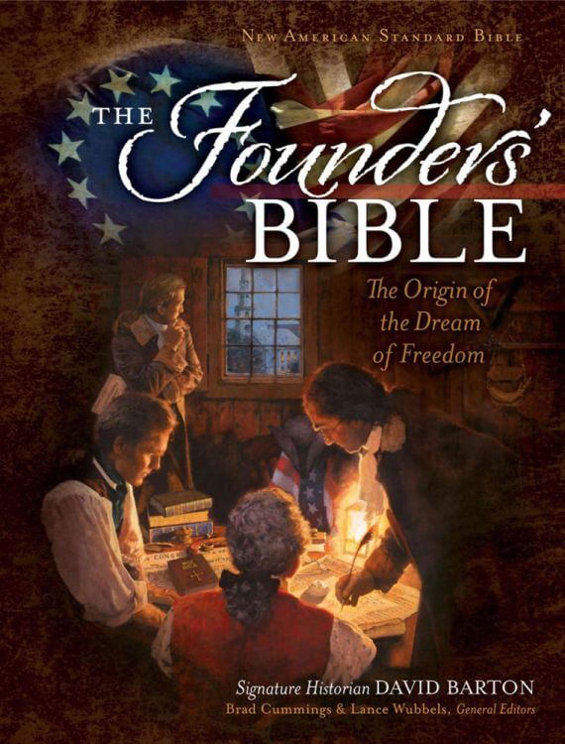
Modern Day Geneva Bible. Can be purchased from Wallbuilders.com

Slide 43
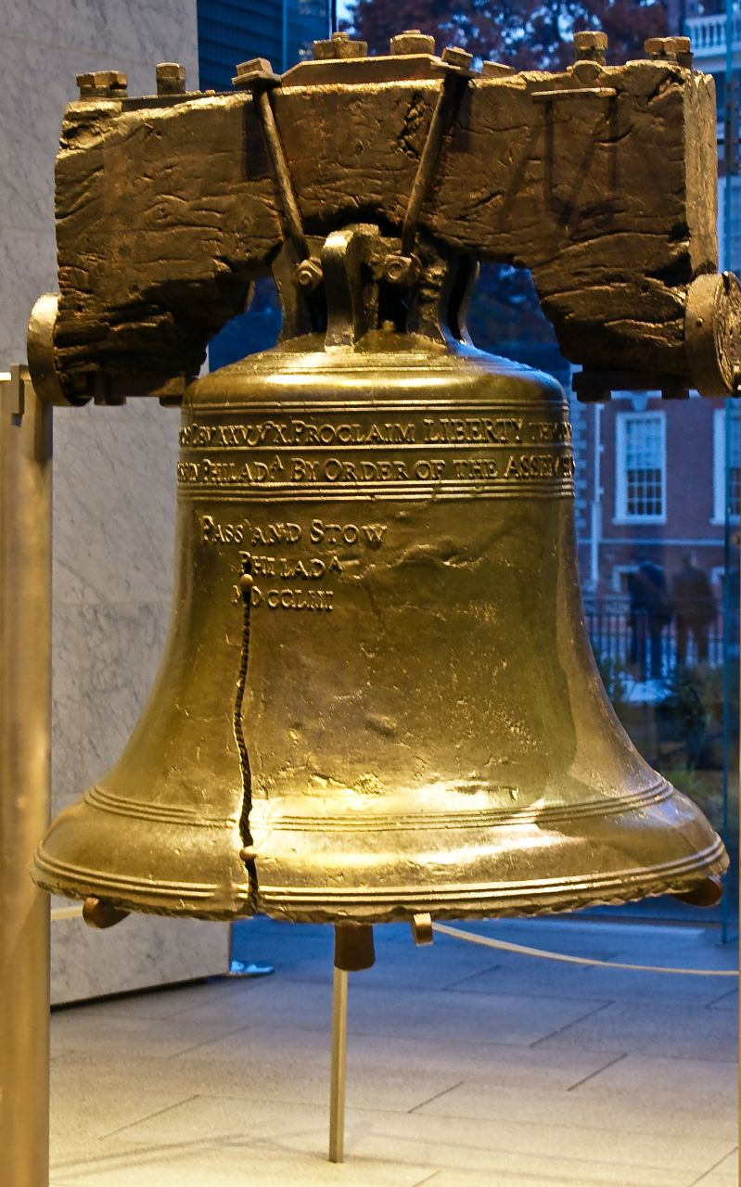
Leviticus 25:10 “Proclaim liberty throughout all the land unto all the inhabitants thereof” (emphasis supplied)

Slide 44
Fun Facts on American History -Our Form of Government was inspired by Scripture
Our Republican form of government:
Exodus 18:21-22 (NASB):
²¹ Furthermore, you shall ^{[a]}select out of all the people able men who fear God, men of truth, those who hate dishonest gain; and you shall place these over them as leaders of thousands, ^{[b]}of hundreds, ^{[c]}of fifties and ^{[d]}of tens. (emphasis supplied)
Thousands, hundreds, fifties and of tens are our different levels of government (city, county, state, federal).

Slide 45
Fun Facts on American History -Our Form of Government was inspired by Scripture
Our three branches of government:
Isaiah 33:22 (NASB):
²² For the Lord is our judge, The Lord is our lawgiver, The Lord is our king; (emphasis supplied) He will save us—
Judge (judicial); lawgiver (legislative); king (executive).

Slide 46
Fun Facts on American History -Our Form of Government was inspired by Scripture
Separation of Powers:
Jeremiah 17:9 (NASB):
“The heart is more deceitful than all else And is desperately sick; Who can understand it?
The founders wanted each branch to keep each other accountable because to much power wielded to the wrong person/branch can lead to disaster. The heart is deceitful.

Slide 48
Truth Behind Separation of Church and State
-This has grossly been taken out of context since 1947
-There is a healthy separation of Church and State (who did God say to take care of the poor? The Church and the individual; not the government)
-this has been taken so out of context that folks feel like they can’t pray in public if they are a representative?
-this was a private letter between Danbury Baptist Church and Thomas Jefferson. In 1801, Danbury Baptist wrote Jefferson a letter saying they were concerned the State would take over the Church, and Jefferson replied back on January 1st, 1802, that there would be a “separation of Church and State.”

Slide 49
Truth Behind Separation of Church and State
-Jefferson’s intent was that the State would not establish a state religion (a theocracy) and part of the reason of the separation with Great Britain
-Where did Jefferson go two days after authoring the letter? Church on Capitol Hill
-Capitol Hill used to have the largest Church services in American history
-Separation of Church and state weren’t found in legislative intent or the First Amendment
-The First Amendment was drafted by a Pastor!!!!!

Slide 50
Truth Behind Separation of Church and State
-Jefferson actually helped fund Bible Societies
-Jefferson drafted two Bibles. One was actually printed by Congress.
-Why did Jefferson have a Koran? The Barbarian Wars
-He was not a Muslim sympathizer as we were funding terrorism.
-9.11.2001 is not our first war on terror – FYI.

Slide 52
Where do we go from here?

Slide 53
Where do we go from here?
-Continue to be salt and light (America changed when we introduced The Sinner’s Prayer).
-Fear God more than Man (Proverbs 1:7).
-Continue to influence your sphere (Jesus spoke to the crowds, but influenced the twelve).
-Fight the local battles. In the American Revolutionary War, battles were fought locally.

Slide 54
Where do we go from here?
-Get in to your Bible. The Bible was a founding document. In order to understand how our homes, workplaces, and society should run, we need to understand the Bible; therefore, READ IT!
-Surround yourself with great people.
-Understand that God has His time line of prophecy.

Slide 55
Where do we go from here?
-Get ready. for persecution. Every day our culture is a modern day Rome, our government is turning in to Nero, and we better be ready to give an account.
-Where do you think we got the Ichthys?
-Stand up for your rights and quit letting the Bible be used against you.
-A proper view of Romans 13.
-Quit rendering unto Caesar the things that are God’s. In America, who is Caesar?

Slide 56
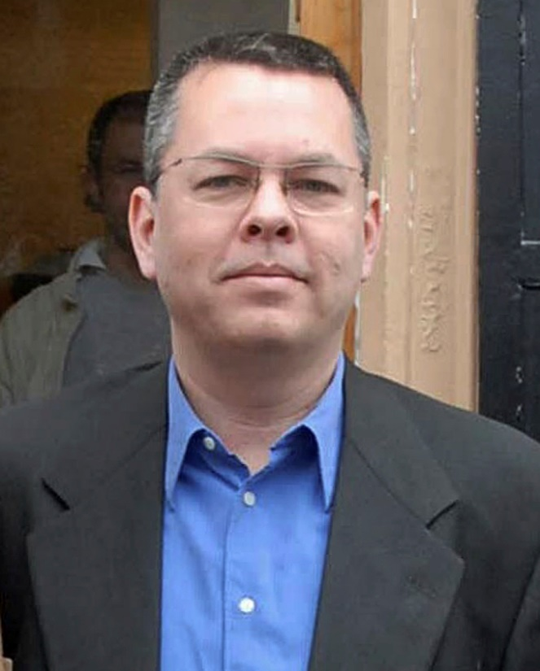
Where do we go from here? Preparing for Persecution
In October 2016, pastor Andrew Brunson was falsely accused of terrorism and held for two years in Turkish prisons. Following a worldwide prayer movement and significant political pressure from the U.S. government, he was released in October 2018. Since then, Andrew has felt an urgency for Christians in the West to prepare for a coming wave of hostility.
During the first year Andrew broke under the pressure. God began to rebuild him. In this eight-part series he shares some of the important things he learned in prison that helped him to stand faithful.
The above paragraph was taken word-for-word verbatim from the Family Research Council’s website.
www.frc.org/preparetostand

Slide 57
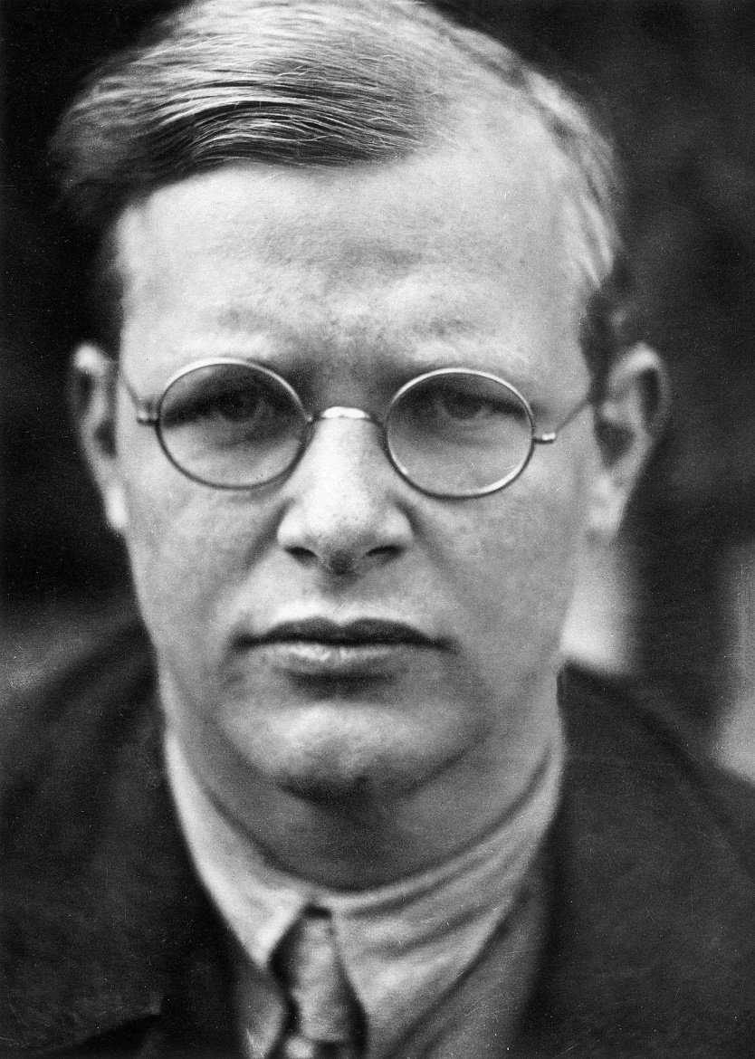
“Silence in the face of evil is itself evil: God will not hold us guiltless. Not to speak is to speak. Not to act is to act.”
-Dietrich Bonhoeffer

Slide 58
Marcia A. Lennick, Constitutional Teacher and Enthusiast!
marciaalennick@hotmail.com
https://marciaalennick.wixsite.com/mysite
https://starsandstripes316.substack.com
www.facebook.com/groups/biblicalcitizenshipgreatfalls
Asking the Church to be salt and light by proclaiming our Biblical,
Historical and Constitutional Heritage.
We must be unequivocal, and unapologetic in our society.
Truth has not changed.

