Slide 1
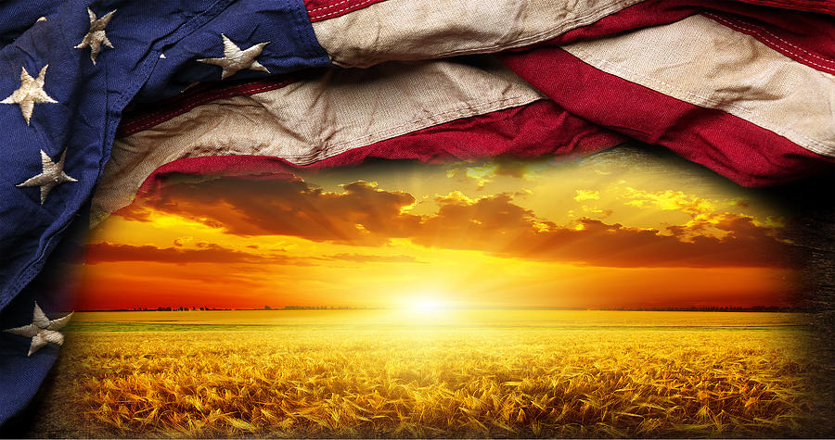
America The Beautiful – Celebrating 250 years!

Slide 2
The Greatest Day of History will ALWAYS be the Cross. After all history is His-Story!

Slide 3
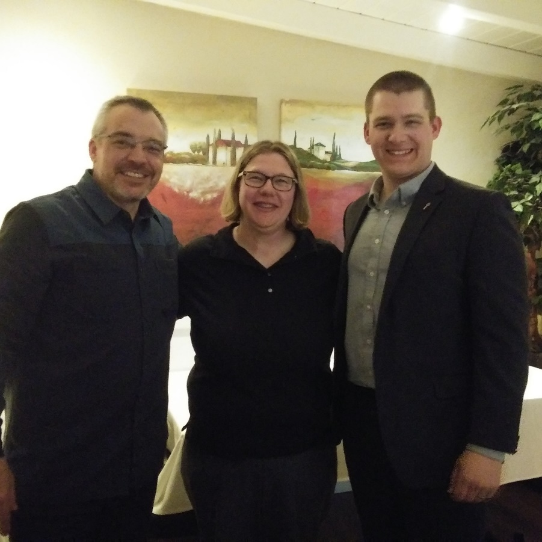
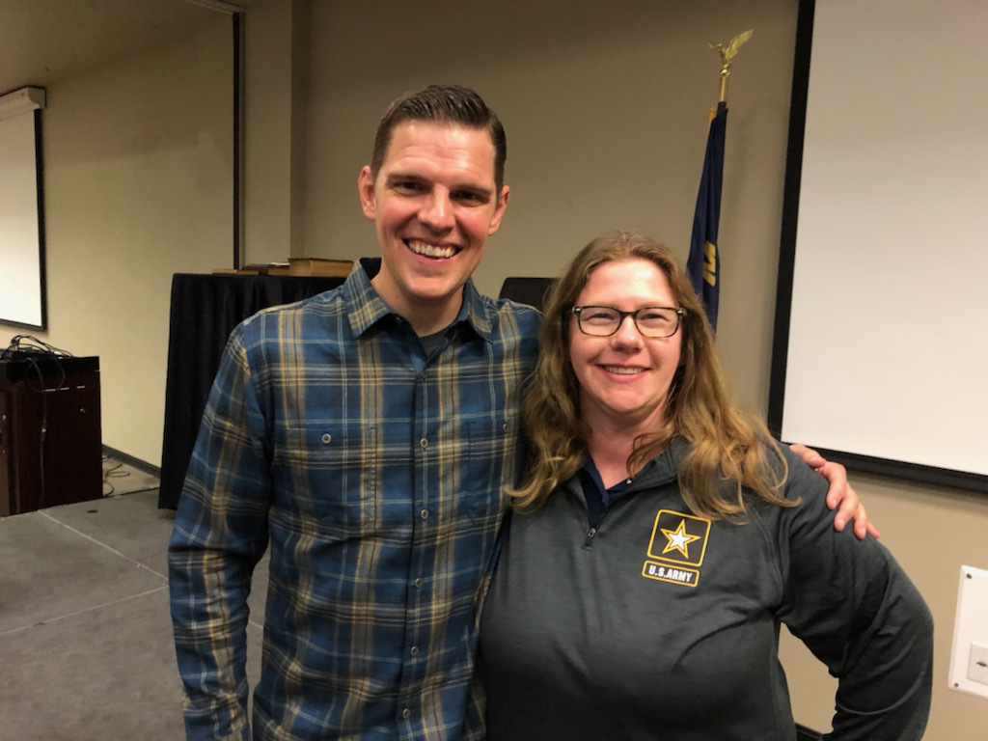
Who I am. My Why!
Notes:
-IN 2008, I WAS ASKED IF AMERICA WAS A CHRISTIAN NATION AND I HAD NO EVIDENCE TO REFUTE OTHERWISE, AND SINCE THEN I HAVE BEEN PUTTING AMERICA ON TRIAL. I STARTED DRATING MY OWN CURRICULUM AND SHARING THE INFORMATION I HAVE GAINED.
-I AM A CONSTIUTION COACH, BIBLICAL CITIZENSHIP COACH, CAMPFIRE COACH, PATRIOT ACADEMY CONSTITUTIONAL DEFENSE GRADUATE.

Slide 4
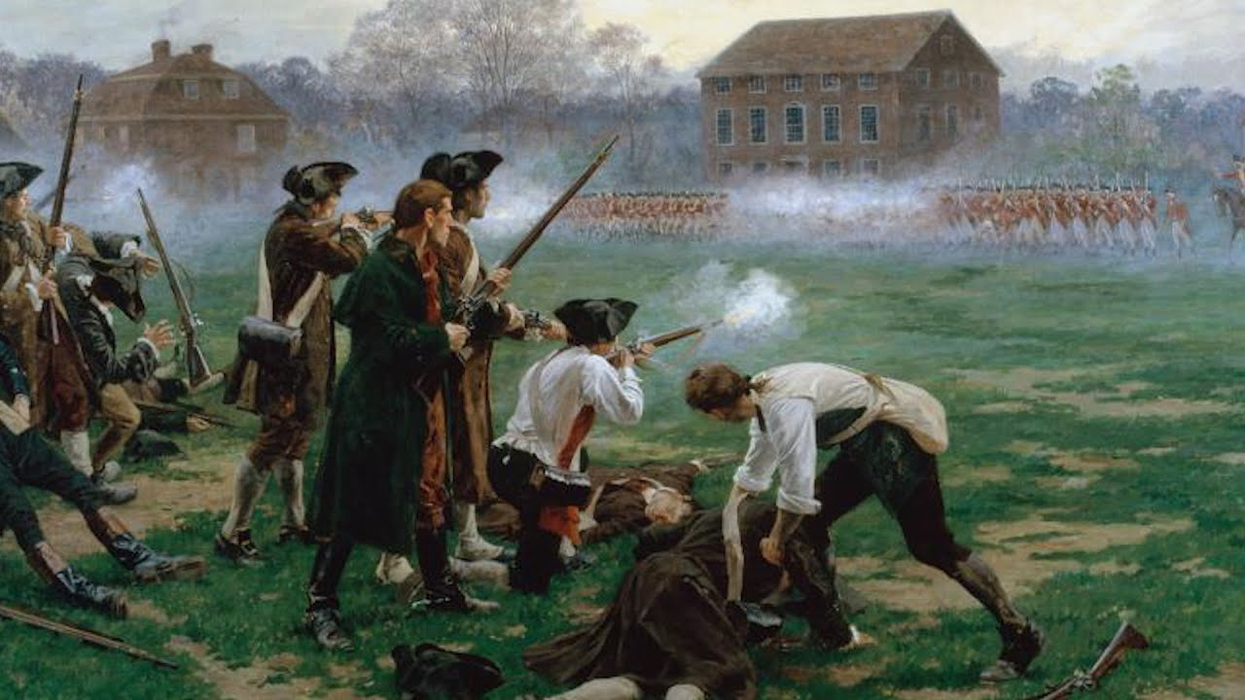
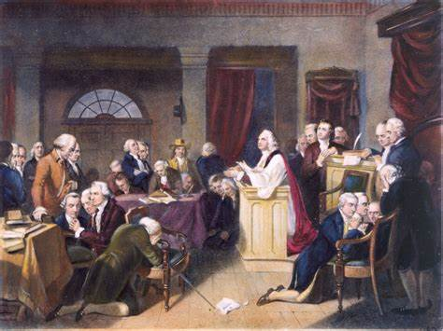
"
America The Beautiful – Celebrating 250 years
The First Prayer in the Continental Congress
9-7-1774 – 9-7-2024
America The Beautiful – Celebrating 250 years
The Shot Heard Around The World
4-19-1775 – 4-19-2025

Slide 5
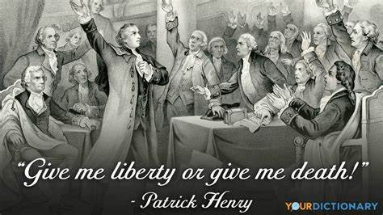
"
America The Beautiful – Celebrating 250 years
“Give Me Liberty or Give Me Death”
3-23-1775 – 3-23-2025
America The Beautiful – Celebrating 250 years
The Shot Heard Around The World
4-19-1775 – 4-19-2025

Slide 6
"
America The Beautiful – Celebrating 250 years
The Shot Heard Around The World
4-19-1775 – 4-19-2025

Slide 7
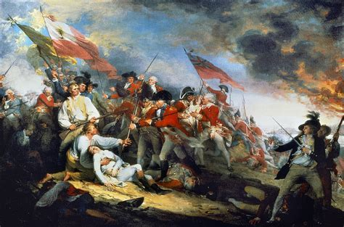
"
America The Beautiful – Celebrating 250 years
The Battle of Bunker Hill
6-17-1775 – 6-17-2025
America The Beautiful – Celebrating 250 years
The Shot Heard Around The World
4-19-1775 – 4-19-2025

Slide 8
America The Beautiful – Celebrating 250 years
Declaring our Independence
7-4-1776 – 7-4-2026

Slide 10
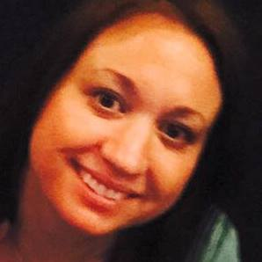
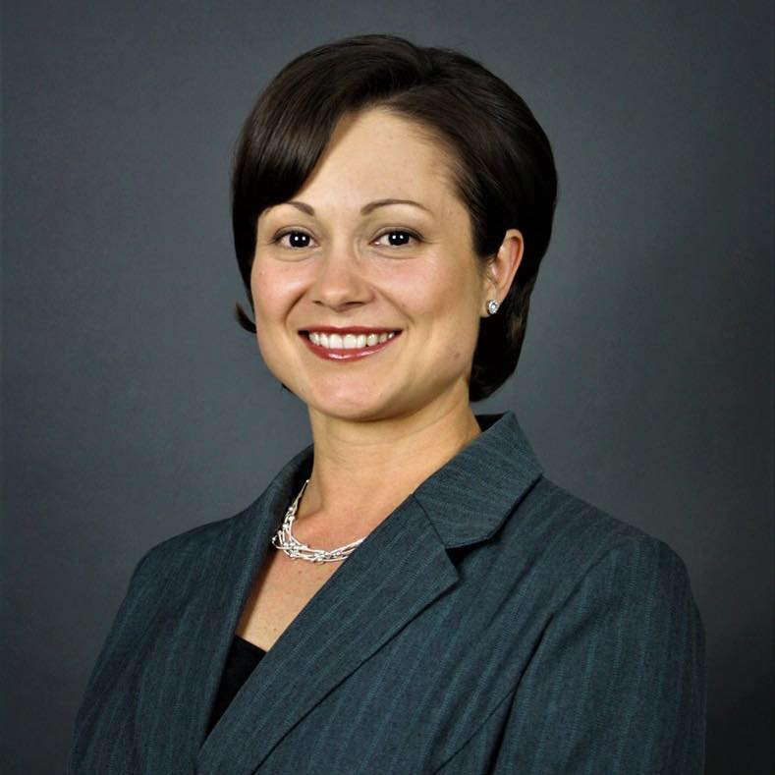
What makes America beautiful?
What other country are these three scenarios possible?
Anna – born and raised in the USA, now a missionary in Africa.
Monica – born and raised in socialist Romania and won the American lottery and came to America. Former dental assistant, now realtor, and her family has appeared on the television show: “The Righteous Gemstones.”
Gloire – a legal immigrant from Africa, whose book Grow Up Church was # 1 on Amazon in Church growth.

Slide 11
What makes America Beautiful?
We get the beauty of choice. In Israel they have to join the military when the government says so.
In WWII we actually let the folks of Hiroshima know we were going to bomb them before we bombed them. What other superpower would do that?
What ever your idea of the American dream is if America ceases to exist so will your American dream.
I never want America to turn socialist or communist. In fact, the Pilgrims tried socialism and did not work. When they used the Biblical mandate of “you don’t work, you don’t eat” that is when the Pilgrims started to succeed.

Slide 13
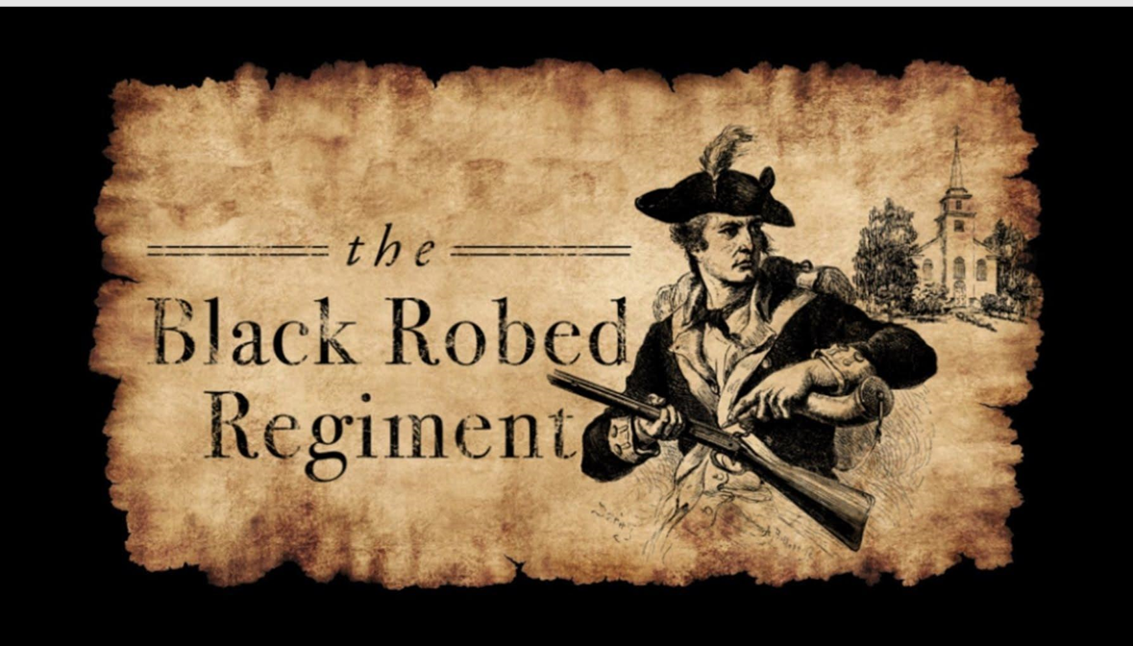
Who were some of the Pastors?
Muhlenberg Brothers – both Pastors
Frederick Augustus Conrad Muhlenberg –First One to sign the First Amendment
John Peter Gabriel Muhlenberg – would call his church to arms after preaching from Ecclesiastes Chapter 3 and the Virginia Regiment would be formed from his church
Reverend Jonas Clark
His words were known to be the primer in the gun on the Lexington/Green
For a copy of his sermon the year after The Shot Heard Around the World go here: Exhibit C

Slide 14
Who were some of the Pastors?
Reverend John Wise
His words would plant seeds for the Sons of Liberty to distribute a book called “A Vindication of the Government of New England Churches”. Get your copy today, Exhibit D
Harry Hoosier
1750-1806: Founding Era preacher from whom Indiana takes its name “Hoosiers”.

Slide 15
Who were some of the Pastors?
-I wish I had more time to go through many more Pastors – like the Pastor would preach the sermon that would bring “Under God” in the Pledge of Allegiance
-Those Pastors who spoke out against The Divine Right of Kings
-How the Reformation with Calvin and Luther planted seeds for the Revolution
-We have had great Pastors throughout all of Christianity – from Whitefield or Wesley or Spurgeon
-Those Pastors who promoted The Doctrine of Lesser Magistrates when the Reformation almost failed

Slide 16
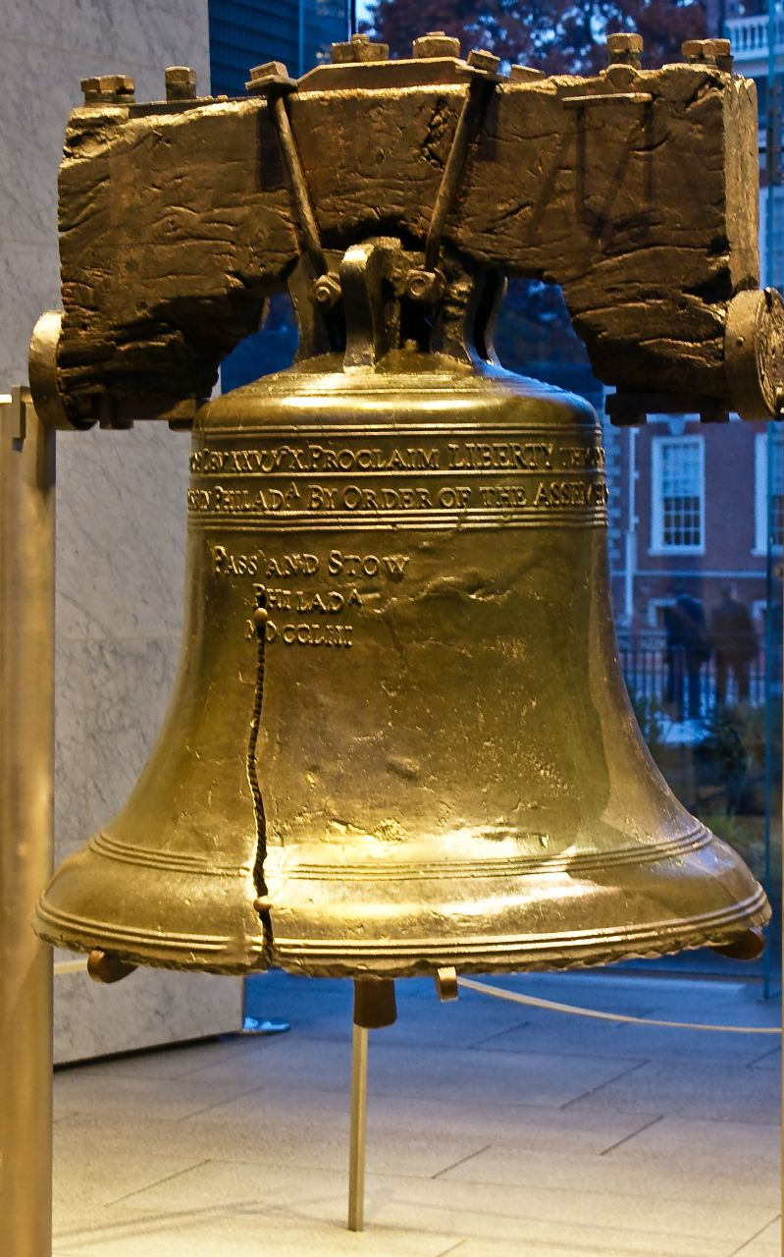
Leviticus 25:10 “Proclaim liberty throughout all the land unto all the inhabitants thereof”

Slide 17
Fun Facts on American History -Our Form of Government was inspired by Scripture
Our Republican form of government:
Exodus 18:21-22 (NASB):
²¹ Furthermore, you shall ^{[a]}select out of all the people able men who fear God, men of truth, those who hate dishonest gain; and you shall place these over them as leaders of thousands, ^{[b]}of hundreds, ^{[c]}of fifties and ^{[d]}of tens.
Thousands, hundreds, fifties and of tens are our different levels of government (city, county, state, federal).

Slide 18
Fun Facts on American History -Our Form of Government was inspired by Scripture
Our three branches of government:
Isaiah 33:22 (NASB):
²² For the Lord is our judge, The Lord is our lawgiver, The Lord is our king; He will save us—
Judge (judicial); lawgiver (legislative); king (executive).

Slide 19
Fun Facts on American History -Our Form of Government was inspired by Scripture
Separation of Powers:
Jeremiah 17:9 (NASB):
“The heart is more deceitful than all else And is desperately sick; Who can understand it?
The founders wanted each branch to keep each other accountable because to much power wielded to the wrong person/branch can lead to disaster. The heart is deceitful.

Slide 20
Fun Facts on American History -Our Form of Government was inspired by Scripture
First, many of the specific ideas presented in the Constitution were developed from the Christian culture of the preceding two centuries. This is confirmed by the extensive work of political scientists who embarked on an ambitious ten-year project to analyze writings from the Founding Era (1760-1805) with the goal of isolating and identifying the specific political authorities quoted during in those writings. If the sources of the specific quotes in those writings could be identified, then the origin of the Founders’ political ideas could be documented

Slide 21
Fun Facts on American History -Our Form of Government was inspired by Scripture
Selecting some 15,000 representative writings, the researchers isolated 3,154 direct quotations, and then documented the origin of those quotations. Their research revealed the single most cited authority in the writings of the Founding Era was the Bible: thirty-four percent of the documented quotes were taken from the Bible—a percentage almost four times higher than the second most-quoted source. A second proof that the Constitution is not secular or Godless is that it was deliberately designed to be utilized alongside the Declaration of Independence—a document that explicitly refers to God multiple times

Slide 22
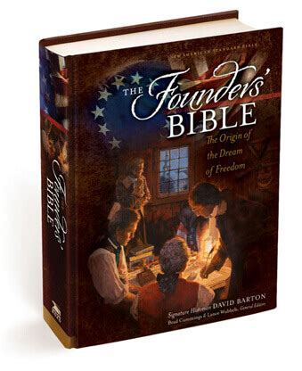
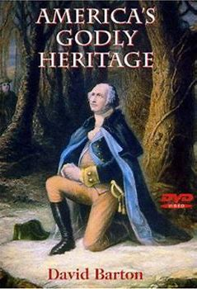
Where am I getting this information?

Slide 25
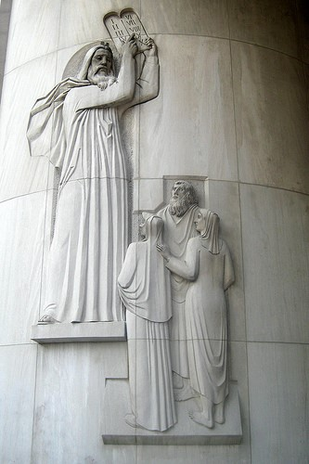
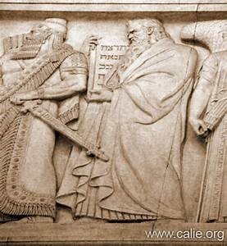
The Ten Commandments
ON THE LEFT;
The Ten Commandments pictured at the US Supreme Court.
ON THE RIGHT:
Moses giving the Israelites the Ten Commandments New York Supreme Court.

Slide 26
The Declaration of Independence
Did you know the Declaration of Independence lists the Deity of God four times???

Slide 27
The Declaration of Independence
-When in the Course of human events, it becomes necessary for one people to dissolve the political bands which have connected them with another, and to assume among the powers of the earth, the separate and equal station to which the Laws of Nature and of Nature’s God entitle them, a decent respect to the opinions of mankind requires that they should declare the causes which impel them to the separation.

Slide 28
The Declaration of Independence
-We hold these truths to be self-evident, that all men are created equal, that they are endowed by their Creator with certain unalienable Rights, that among these are Life, Liberty and the pursuit of Happiness.

Slide 29
The Declaration of Independence
-We, therefore, the Representatives of the United States of America, in General Congress Assembled, appealing to the Supreme Judge of the world for the rectitude of our intentions, do, in the Name, and by the Authority of the good People of these Colonies, solemnly publish and declare, That these United Colonies are, and of Right ought to be Free and Independent States;

Slide 30
The Declaration of Independence
-And for the support of this Declaration, with a firm reliance on the protection of divine Providence, we mutually pledge to each other our Lives, our Fortunes, and our sacred Honor”

Slide 34
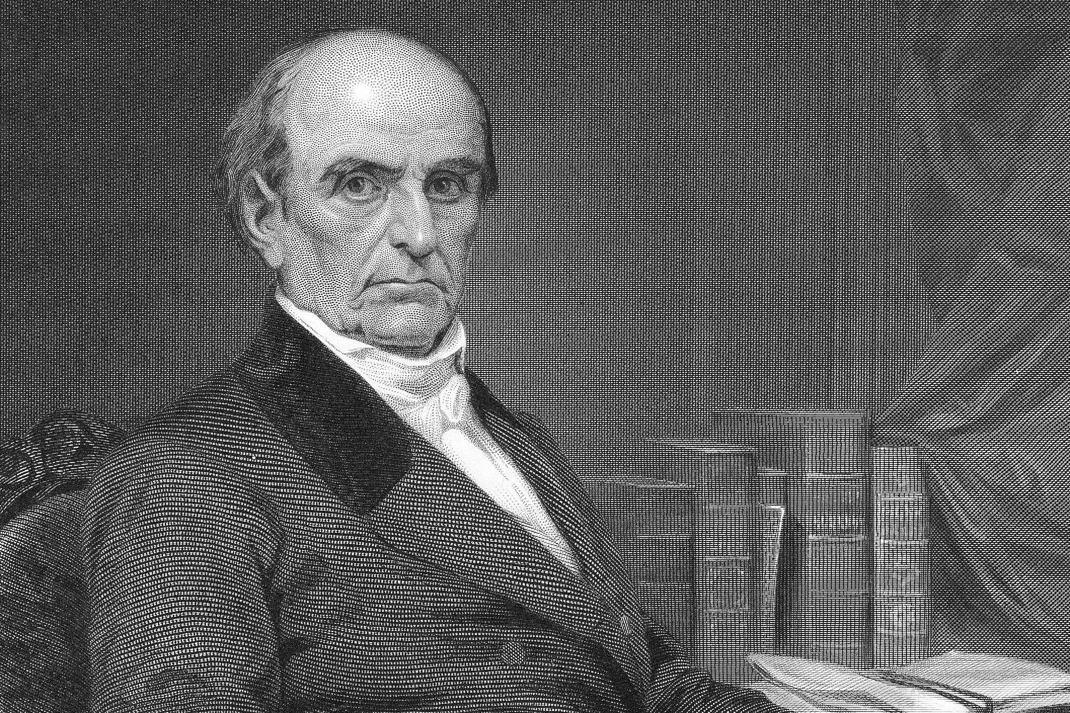
“History Comes to Life”

Slide 35
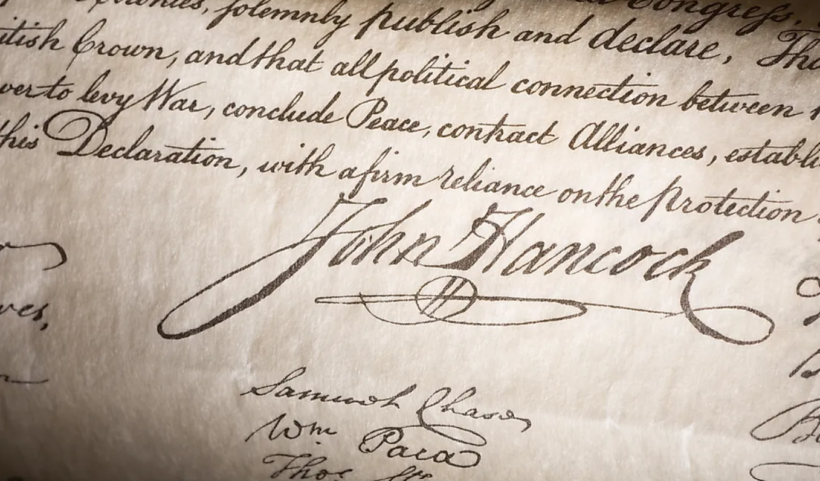
“History Comes to Life”
“You get to sign the Declaration of Independence”

Slide 37
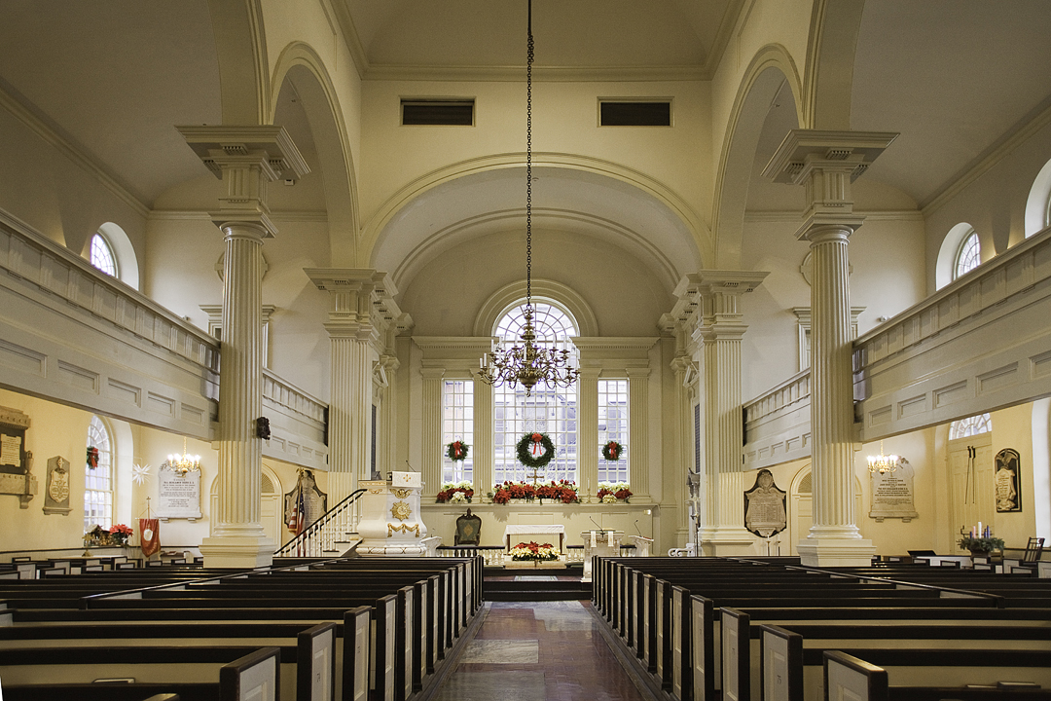
Questions for your Pastor, new Pastor, board member, or potential new board member!

Slide 38
Questions to ask Pastors, new Pastors, potential church board members:
How do you define success? George Barna study showed this is how Pastors define success:
attendance, giving, number of programs, number of staff and square footage.
2) What is your view of Romans 13? Look at the Heroes of the Hall of Faith — all of them defied government.
Revelation 21:8 clearly states the cowards will not inherit the Kingdom of God. Are we cowardly when we are silent?
3) If you are the Shepherd of the sheep, who are the wolves and how do you intend to protect the sheep? Should we defy government? (A good resource is Lex Rex).
4) Are you a theological conservative (actually believing the entire Bible is without error?

Slide 39
5) Do you believe the Bible speaks to all areas of life?
6) Are you willing to preach on all areas of life?
7) How do we make disciples?
8) When should we submit to government and when should we defy government? (A good resource is Lex Rex (it can be purchased here)
9) Why do we render the things unto Caesar that are God’s? Do we know what is God’s or Caesar’s?​
-From Tim Barton of Wallbuilders when asked "What do I ask a new potential Pastor as I am the search committee as my Senior Pastor is retiring"? 9/24/2022

Slide 41
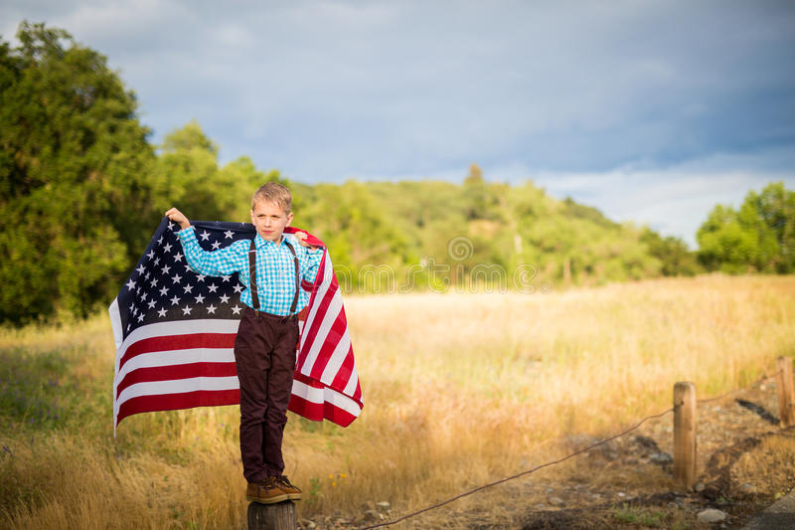
1- God must be # 1 no matter what. Make the memories. Have breakfast as a family and read the Bible.
2- Teach your kids that faith is not a burden. That going to church isn’t a chore. We get TO DO THIS. We don’t have to do this.
3- Keep perspective. God has called you hear for a time such as this.
4-Thankful heart. Read the Founders and see how they lived and impart that on your children. David Barton was impacted by a writing by Benjamin Rush that he essentially thanked God for the blessings He forget to thank God for.
5-Be intentional. Reaffirm God’s Truth in to your kids.
​
-From Tim Barton of Wallbuilders when asked "How to raise kids Patriotic"? 9/24/2022
A few questions to ask yourself: 1) can we continue down this moral decay and continue as a nation? 2) can we continue on down this path of financial debt? 3) is our hope in American politics or the God that America was founded upon? 4) can we stop Bible prophecy? 5) is America listed in Bible prophecy?

Slide 42
www.starsandstripes316.com

