Slide 1


Black History
By: Marcia A. Lennick

Slide 2

Welcome!
Prayer
Thank you to Veterans
Silent phones
My goal is to go to other churches and do this presentation. I am willing to travel. If you know someone that would be interested, lets chat afterwards.
My goal is also to have more lecture series down the road. Topics could include immigration, discipleship or history of education!
Since the inception of this Black History study, someone has asked me to do a study on Kirk Cameron’s Monumental series and the Forefather’s Monument.
If there is a lecture series you would be interested in , please let me know.

Slide 3
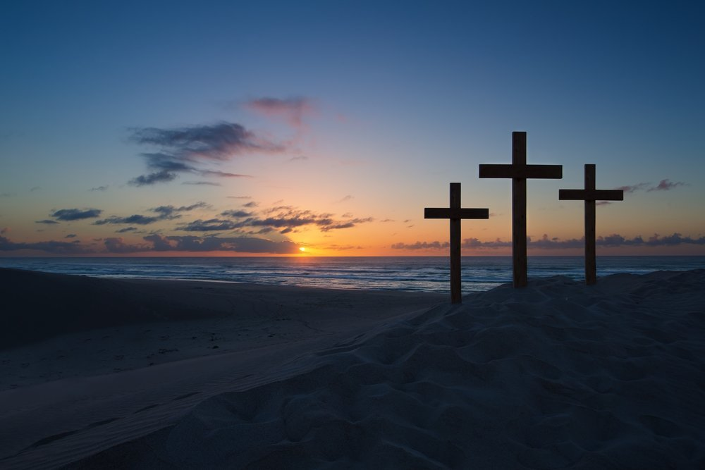
-The greatest day in History
-The greatest day in my History
-The greatest day in your History will always be The Cross.
Let me know if you have questions!

Slide 4
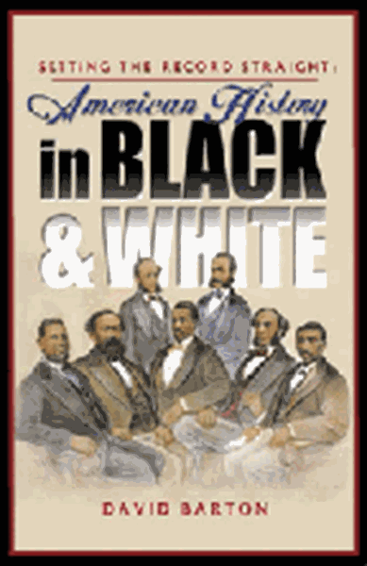
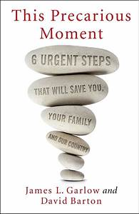
Resources used for this lecture
Setting the Record Straight is a unique view of the religious and moral heritage of black Americans, with an emphasis on the untold yet significant stories from our rich political history
This Precarious Moment.
Why I use Wallbuilders? Their information is actually cited. Look at your exhibits vs. The Godless Constitution.
Please see the handouts included in your packet called: “Wallbuilders”, “Patriot Academy” to see all the great activities that they are involved in!
Disclaimer: I am not hired by Wallbuilders. I am simply a supporter of their organization. I am using their information WITH THEIR PERMISSION!

Slide 5




More Resources for Historical Information
See very last slide for websites to these organizations!

Slide 6
What to expect during this lecture series?
Racial Healing – what is racism?
Why did slavery happen from a Biblical, historical and Constitutional perspective?
I would encourage all folks to look up Biblical references used as well as to read the exhibits provided. Also, I would encourage folks to use and look up additional resources cited earlier.
A good review of the timeline of American Slavery.
Black History
  What has happened that we do not know about blacks in our history?
  Why do we have the 3/5 clause in the Constitution?
  Why didn’t we abolish slavery in our founding?

Slide 7

Called by God
I feel called to be a Nehemiah – to help rebuild the walls of America Biblically, Historically and Constitutionally.
I feel called to be an Esther – to help America understood her Judeo-Christian roots and to stand up for the Jewish people.
“My people are destroyed for lack of knowledge.” – Hosea 4:6
Where there is no vision, the people perish. – Proverbs 29:18

Slide 8
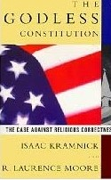
What has happened in modern history?
We take items out of context:
  For example, those who knew me in high school vs. today would know me in a different light. So, someone could put a quote I said in high school out on a billboard for folks to see.
We simply just do not talk about our historical figures. Without us talking about them, then we can make up stories about them.
  We just talk about a few folks, and forget everyone else.
    The Church is just as guilty on this account; we talk about Paul and a few of the greats and forget everyone else.
      We must remember the Holy Spirit did not waste ink when he pressed it upon 40 different authors to draft the Bible within 1500 years.

Slide 9
How should we review The Bible and/or history?
Look at the good, the bad, the ugly, and get the truth.
Look at the hermeneutics – who, why, where, and what was going on at the time? Look at the event/Scripture in alignment with all of these, as well as the Chapter, Book, and the Bible as a whole when reading.
We do not need to change the facts of The Bible or history to align with our viewpoints. Truth is still truth.
When we take items out of context we are CONNED by the TEXT.
I treat the Bible as the authoritative Word of God and The Bible is self-authenticating.
I am an originalist with our founding documents meaning looking at items in “original context” – and not treating America’s founding documents as living and breathing.

Slide 10

How should we view America today?
God is still on the throne and some of where America is at today, I am excited about.
  For example, “The In God We Trust Movement”:
How about with a Caleb heart. We look at our nation on the basis of what God can do as He is still on the throne. We must be faithful to what He has called us to.
  Caleb, along with Joshua, was one of the original twelve spies sent into the Promised Land to scout the area. While everyone else was too afraid to conquer Canaan, Caleb and Joshua announced that there would be no trouble for the Israelites. Numbers 13-14.

Slide 11
Why History Matters?
If we do not know history, we are doomed to repeat the mistakes of the past.
-Ancient Israel was always in this boat until a righteous person would rise up and tell the King or Law Giver about the Book of the Law. Once the nation turned back to God, His blessings prevailed.
-Look at your sphere of influence.
-Look at the righteous people in the Bible and their sphere of influence (Nehemiah and Queen Esther).

Slide 12
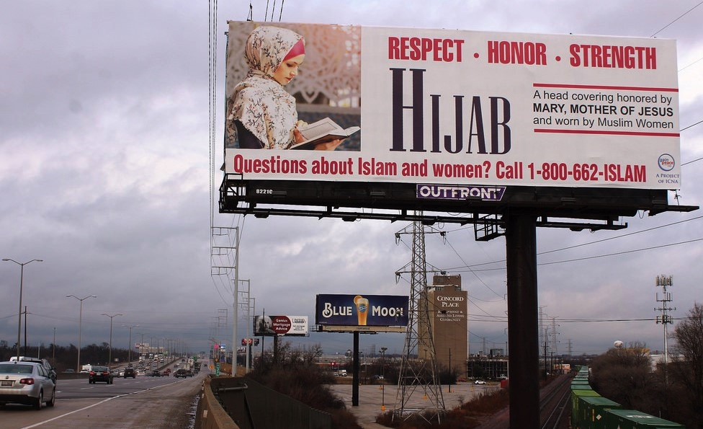
Why History Matters?
Is this billboard historically accurate? Why or why not?

Slide 13

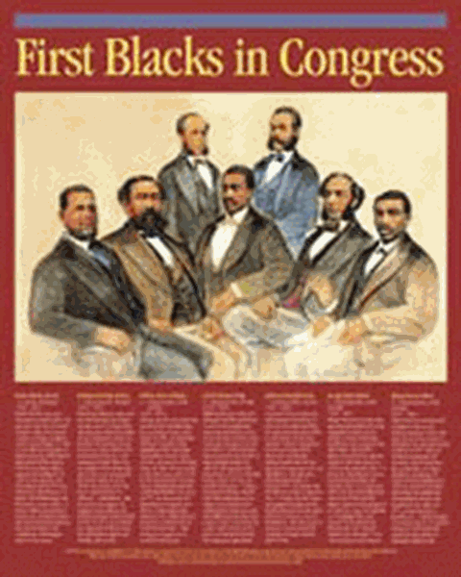
How many know what this picture is?
How many can actually name black historical heroes?

Slide 14
Some hard truths about black history
Black history has been abolished from the history books. This happened in the 20th Century.
  We must also understand that history in general is being deleted. How many just grew up knowing Thomas Jefferson or Benjamin Franklin? None of us know about Governour Morris, James Wilson, Benjamin Rush, Fisher Aimes, or Daniel Webster – The Great Orator.
  None really know William Blackstone’s ideas of “The Laws of Nature and Nature’s God”
  None really know about The Two Treatise of Government by John Locke which cites over 1500 Bible Verses.
  Many do not recognize that we have over 250 founding fathers; not just the guys who signed our founding documents.
More ways black history is being deleted. For example, there are actual statutes being displayed that do not depict MLK, Jr. as a Reverend. There have been grave concerns about the Smithsonian erasing information; especially black history.
We should honor our black patriots who also paid the ultimate sacrifice with their lives.
Slavery also ended with the help of white people.
What are some accounts of racism you have experienced?
Will racism be abolished 100%? We all have our semantics and pre-conceived ideas.

Slide 15
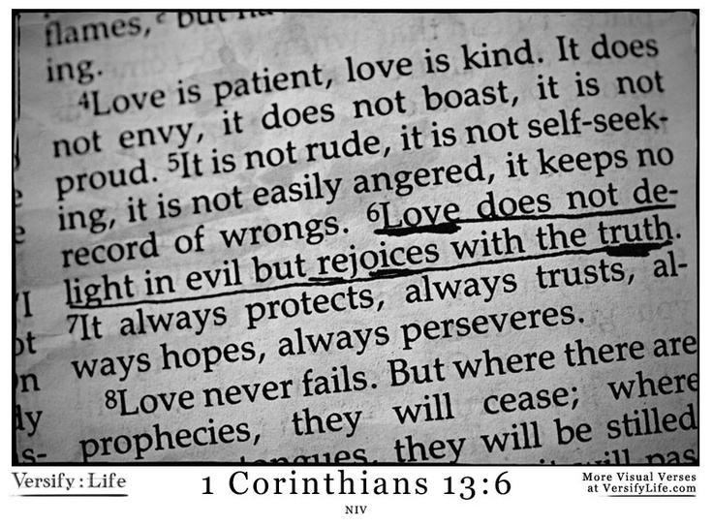
Racism gone too far!
We also live in a time and place where the idea of racism has gone to far. Like we cannot listen to “White Christmas” is racist because of the word “white” is in this song!
I try to address this lecture out of love –1st Corinthians 13:4-7

Slide 16
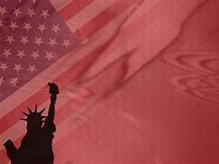

Establishing a Foundation
We need to deal with the idea of race and racism in the Church, and lets get a Biblical, historical and constitutional perspective so we can move forward with our lives and in our nation.
Once we learn these principles, we can have the Church God wants: multiethnical and multigenerational!
When America was founded, our Founding Fathers wanted people to be able to live out their culture, beliefs, etc. as long as it did not violate God’s Law. Our FF wanted people to have the free will to choose; how God gives us free will to choose Him or to not choose Him.
We do need to be careful when studying culture to not let in foreign gods. God warned ancient Israel about this. Remember what happened to King Solomon? 1 Kings 11.

Slide 17
Current Thoughts in America
What are some thoughts in our culture?:
  Whites accuse blacks of whining when blacks bring up inequalities in life or go back to historical injustices.
  Whites accuse whites of pandering when they try to understand the blacks on racial issues.
  Blacks accuse whites of being racist when whites speak out against policies, or beliefs, or practices of black leaders.
  Blacks accuse other blacks of being “Uncle Toms” when they agree with whites on topics that black leaders are against.

Slide 18
Establishing a Foundation
Racism is a heart problem – a problem of sin.
It is viewed as a political problem or an economic problem.
At the root, it is a spiritual problem.
On a side note, we are not saying it should not be dealt with politically or economically. There are good and bad policies to assist with racism.
No policy or economics can change the heart man only God can.
Racism is a violation of Biblical truth, true genuine healing will come when one repents of resentment towards those with a different skin color or ethnic culture.

Slide 19
Defining Race
For this lecture series, lets define racism.
For starters, we need to understand racism has been a problem in the heart of man since our existence.
Racism involves the idea that one race is superior to another race or that a particular racial group is inferior to another.
Over time the term race and ethnicity are being used incorrectly.
Since the 1950’s The United Nations does not acknowledge race, but rather ethnicities.
From a Biblical viewpoint, there is only one race, but for this study will use terminology “white race” and “black race”.

Slide 20
What does the Bible say about race and ethnicity?
In the NT, the word “ethnos” is found. In the OT, a similar word to “ethnos” is found. This is how we get the word “ethnicity.”
In the Bible, God only divides humans in to two main groups:
1) those who know Him; 2) those who do not know Him.
God is not concerned with race.
  A person could be Jewish and can obey the Torah and be Semitic, Hispanic, Black Slavic, etc.
  Same with the Christian person.
  It is the relationship with Christ that matters.
Race, ethnicity and skin color will all pass away.

Slide 21
The Danger of Identity Politics
We are seeing a cultural shift in America where we are moving away from the Biblical process of looking at our fellow human beings as the human race or human beings in general and categorizing people based upon race and ethnicities a/k/a identity politics.
  Individual Americans are categorized based upon: are they are Latino, black, white, gay, straight, Muslim, union members, and the list is endless.
  In doing this we are passing laws and hate crimes to single out groups.
  We got here by dedicating certain months to certain groups and there are months dedicated to emphasize certain groups: black history, women’s history, Asian Pacific American History, Jewish American History, LGBT Pride/History, and the list goes on.
    If there is not a month for your specific group, did you know you are being discriminated against?
God’s approach to all this: His practice of recognizing the individual as part of the human race.

Slide 22
Race, Nations and Culture are different!
Race and nations are two separate items in the eyes of God. God is a God that draws the line for nations. We could actually talk about immigration based on this idea, but that is for a different lecture series.
  Acts 17:26(NIV): From one man he made all the nations, that they should inhabit the whole earth; and he marked out their appointed times in history and the boundaries of their lands.
We must understand there is equality in the eyes of God as He sees us as part of the human race; however, that does not mean the individual’s culture is the same.
  1 Corinthians 9:20-22 (NIV): ²⁰ To the Jews I became like a Jew, to win the Jews. To those under the law I became like one under the law (though I myself am not under the law), so as to win those under the law. ²¹ To those not having the law I became like one not having the law (though I am not free from God’s law but am under Christ’s law), so as to win those not having the law. ²² To the weak I became weak, to win the weak. I have become all things to all people so that by all possible means I might save some.
  Certain customs will be associated with specific people groups (culture). Even look at the U.S.A. – our culture is way different in rural vs. urban areas, or lets say Montana vs. Louisiana.
    I am glad I am a Montanan!

Slide 23
The Bible and Slavery
Many today see America’s founders as hypocrites. How could they be “Christian”, slave owners and promote liberty and equality?
How has the idea of equality changed from our founding to today?
  I.E. The potential Equality Act.
Are the Founding Fathers the blame for the evils of slavery?
Slavery happens in many forms: spiritual, mental and physical.
Original intent is absolutely necessary when looking at America’s history.
  Does anyone know what unalienable rights are?

Slide 24
The Bible and Slavery
Slavery was a byproduct of the fall of man.
Slavery was not part of God’s original design in Genesis.
Christian nations have led the way in the abolitionist of slavery.
When God gave Moses the Law, slavery was part of the world making the law of God recognize slavery.
Just because it was recognized does not mean it was in God’s original intent just like the idea of divorce.

Slide 25
The Bible and Slavery
The Mosaic law permitted some types of slavery. These include:
  Indentured Servants
  Voluntary Permanent Slaves
  Thief or Criminal Making Restitution
  Pagans

Slide 26
The Bible and Slavery
Indentured Servants
Indentured Servants
Voluntary servitude by the sons of Israel (indentured servants) who needed assistance, could not pay their debts, or needed protection from another were allowed under Biblical law to become indentured servants (see Ex. 21:2-6; Deut. 15:12-18).
Were dependent on their master instead of the state. This was a way to aid the poor and give them an opportunity to get back on their feet. It was not to be a permanent subsidy. Many early settlers to America came as indentured servants. These servants were well treated and when released, given generous pay.

Slide 27
The Bible and Slavery
Indentured Servants
When slaves (indentured servants) were acquired under the law, it was their labor that was purchased, not their person, and the price took into account the year of freedom (Lev. 25:44-55; Ex. 21:2; Deut. 15:12-13).
There are a laws in the Bible related to slavery. They include:
  Hebrew slaves (indentured servants). were freed after 6 years. If you buy a Hebrew slave, he shall serve for six years; but on the seventh he shall go out as a free man without payment (Ex. 21:2).
  If your kinsman, a Hebrew man or woman, is sold to you, then he shall serve you six years, but in the seventh year you shall set him free. And when you set him free, you shall not send him away empty-handed (Deut. 15:12-13).

Slide 28
The Bible, Slavery, and America’s Founders
Indentured Servants
Any slave showing a desire for freedom was to be safely harbored if they ran away. In violation of this law, many Christian slaves in America were not given the option of freedom after six years (and many escaped slaves were forcefully returned).
To comply with the spirit and law of the Old and New Testament, non-Christian slaves should have been introduced by their master to Christianity, equipped to live in liberty, and then given the opportunity to choose to live free. Christianity would have prepared them to live in freedom.

Slide 29
The Bible, Slavery, and America’s Founders
Voluntary Permanent Slaves
Voluntary permanent slaves: If indentured servants so chose, they could remain a slave (Ex. 21:2- 6; Deut. 15:16-17) making them voluntary permanent slaves.
  Their ear was pierced to indicate this permanent subjection.
  The law recognized that some people want the security of enslavement.
  Today, there are some people who would rather be dependent upon government to provide their needs (and with that provision accepting their commands) than do what is necessary to live free from its provision and direction. Some even act in a manner that puts them in jail, desiring the care and provision they get more than personal freedom.

Slide 30
The Bible and Slavery
Thief or criminal making restitution.
Thief or criminal making restitution.. A thief who could not, or did not, make restitution was sold as a slave: “If a man steals . . . he shall surely make restitution; if he owns nothing, then he shall be sold for his theft” (Ex. 22:1,3).
The servitude ceased when enough work was done to pay for the amount due in restitution.

Slide 31
The Bible and Slavery
Pagans
Pagans could be permanent slaves. Leviticus 25:44-46.
Foreigners
Foreigners: You may require payment from a foreigner, but you must cancel any debt your fellow Israelite owes you. Deuteronomy 15:3

Slide 32
The Bible and Slavery
Other Information and Facts
Involuntary Servitude is Not Biblical.
Exodus 21:16 says: “He who kidnaps a man, whether he sells him or he is found in his possession, shall surely be put to death.”
Deuteronomy 24:7 states: “If a man is caught kidnapping any of his countrymen of the sons of Israel, and he deals with him violently, or sells him, then that thief shall die; so you shall purge the evil from among you.”

Slide 33
The Bible and Slavery
Other Information and Facts
Freed slaves were released with liberal pay. When these slaves were set free they were not to be sent away empty handed. They were to be furnished liberally from the flocks, threshing floor, and wine vat.(Deut. 15:12-15).
Slaves were to be responsible. We have mentioned that some people prefer the security of enslavement to the uncertainty of living free.
People who live free have certain responsibilities they must maintain. They cannot have the fruit of freedom without the responsibilities of freedom

Slide 34
The Bible and Slavery
Other Information and Facts
Runaway slaves were to go free.
Deuteronomy 23:15-16 says that a runaway slave was to go free. He was to be welcomed to live in any of the towns of Israel he chose. The Israelites were not to mistreat him.
Excessive punishment of slaves was forbidden.
A slave could be punished by striking with a rod (Ex. 21:20-21), but if the punishment was excessive, the slave was to be given his freedom (Ex. 21:26-27; Lev. 24:17).
  This included knocking out the tooth or damaging the eye. This applied to indentured servants as well as other slaves.
Since the owner would lose his investment in such a situation, there was a financial incentive for just treatment. Just treatment of slaves was required of the masters. Paul writes: “Masters, grant to your slaves justice and fairness, knowing that you too have a Master in heaven.” (Col. 4:1)

Slide 35
The Bible and Slavery
Other Information and Facts
Slaves could be brought into the covenant. Slaves could be circumcised (brought into the covenant) and then eat of the Passover meal (Ex. 12:43-44; Gen. 17:12-13). Slaves could also eat of holy things (Lev. 22:10-11).
Slaves had some rights and position in the home and could share in the inheritance. (See Gen. 24:2 and Prov. 17:2.)
Slaves were to rest on the Sabbath like everyone else. The Fourth Commandment applied to all (Ex. 20:8-11).

Slide 36
The Bible and Slavery
Other Information and Facts
Female slave laws were for their protection.. Exodus 21:4-11 gives some laws about female slaves, which served for their protection. These Hebrew female slaves were without family to assist them in their need or to help to provide security for them. These slaves laws were a way to protect them from abuse not faced by males and to keep them from being turned out into the street, where much harm could come to them.
See Exhibit C: The Bible, Slavery and America’s Founders.

Slide 37
The Bible and Slavery
What did the NT say about slavery?
Slavery and the New Testament: When Paul wrote how slaves and masters were to act (Eph. 6:5-9; Col. 4:1; 1 Tim. 6:1-2; Col. 3:22-25; Titus 2:9-10), he was not endorsing involuntary slavery or the Roman slave system. He was addressing the attitudes, actions, and matters of the heart of those Christians who found themselves in slavery or as slave owners. This encompassed many people, for half the population of Rome and a large proportion of the Roman Empire were slaves. Many people were converted to Christianity while slaves or slave owners, and many Christians were enslaved.

Slide 38
The Bible and Slavery
What did the NT say about slavery?
It is in this context that we can better understand the example of Paul, Onesimus, and Philemon. Onesimus, a slave of Philemon who apparently stole some money from his master and ran away, encountered Paul in Rome and became a Christian. Paul sent him back to his master carrying the letter to Philemon. Author of the famous Bible Handbook, Henry Halley writes:
  The Bible gives no hint as to how the master received his returning slave. But there is a tradition that says his master did receive him, and took Paul’s veiled hint and gave the slave his liberty. That is the way the Gospel works. Christ in the heart of the slave made the slave recognize the social usages of his day, and go back to his master determined to be a good slave and live out his natural life as a slave. Christ in the heart of the master made the master recognize the slave as a Christian brother and give him his liberty. There is a tradition that Onesimus afterward became a bishop of Berea. 7 The Mosaic slave laws and the writings of Paul benefited and protected the slaves as best as possible in their situation. God’s desire for any who are enslaved is freedom (Luke 4:18; Gal. 5:1). Those who are set free in Christ then need to be prepared to walk in liberty. Pagan nations had a much different outlook toward slaves, believing slaves had no rights or privileges. Because of the restrictions and humane aspect of the Mosaic laws on slavery, it never existed on a large scale in Israel, and did not exhibit the cruelties seen in Egypt, Greece, Rome, Assyria and other nations.

Slide 39
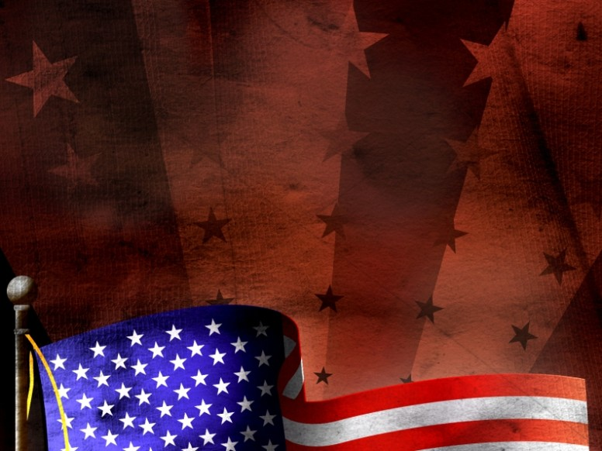
Review!
What did you think of what we learned tonight?
Did any ideas, perceptions, or understandings change?
Next week:
  Briefly touch on world slavery and I mean brief!
  American Slavery
    Why did we have the 3/5 clause in the constitution?
    Timeline of slavery in America
    How the timeline of the civil rights movements affects culture today!
  Review of some of America’s black patriots and heroes.
  What can you do in culture around you?

Slide 40
The Bible and Slavery and America’s Founding Fathers
Other Information and Facts
Eventually, Christianity would overthrow slavery, not so much by denouncing it, but by promoting the equality of man under God, and teaching the principles of liberty and the brotherhood of mankind under Christ. It would be the responsibility of Christians, especially those who found themselves in a place of owning slaves (for example, many Christian Americans in the past inherited slaves) to teach such ideas, and then act accordingly.
Many Christians in early America did just this. Phyllis Wheatley was introduced to Christianity by her masters, educated, and given her freedom. Many American Christians, in both North and South, at the time of the Civil War did much to educate slaves Biblically. Stonewall Jackson, who never owned slaves himself and was against slavery, conducted many classes in his church to educate slaves.
Would slavery ended if these seeds were not planted?

Slide 41

Understanding World Slavery
Sinful man will always live in some form of bondage and slavery, as a slave to the state, to a lord or noble, or to other men.
As a step in man’s freedom, God’s laws of slavery provided the best situation for those who find themselves in bondage. God’s ultimate desire is that all walk in the liberty of the gospel both internally and externally.
As the gospel principles of liberty have spread throughout history in all the nations, man has put aside the institution of overt slavery. However, since sinful man tends to live in bondage, different forms of slavery have replaced the more obvious system of past centuries. The state has assumed the role of master for many, providing aid and assistance, and with it more and more control, to those unable to provide for themselves. The only solution to slavery is the liberty of the gospel.
Slavery has existed throughout the world since after the fall of man. Egypt and other ancient empires enslaved multitudes. Greece and Rome had many slaves, taken from nations they conquered. Slavery was a part of almost every culture.
While some Christian nations had taken steps to end slavery, it was still an established part of most of the world when America began to be settled.

Slide 42

American Slavery - overview
Was part of the American landscape for 240 years. Officially ended in 1865.
Just because slavery ended, slavery manifested itself by lynching, discrimination.
Thomas Jefferson’s first draft of the Declaration of Independence included anti-slavery language.
How come when America signed The Articles of Confederation, The Constitution, The Declaration of Independence or the Bill of Rights, why wasn’t slavery done away with at the time?
  What about women’s rights at the time?
  We were becoming a more perfect union.

Slide 43
Why the 3/5 Clause in the Constitution?
What is the 3/5 Clause?
  Part of Article 1, Section 2 of the US Constitution says: “Representatives and direct Taxes shall be apportioned among the several States which may be included within this Union, according to their respective Numbers, which shall be determined by adding to the whole Number of free Persons, including those bound to Service for a Term of Years, and excluding Indians not taxed, three fifths of all other Persons.”
  Some say our Founding Fathers were saying that black people were 3/5 of a person. In truth, the 3/5 clause was anti-slavery language to limit the political power of slavery’s proponents. By having this clause, Southern States were denied more pro-slavery representation in Congress.
  See Exhibit D: The Founding Fathers and Slavery

Slide 44
America’s Founding
In early American founding, state constitutions protected blacks’ right to vote which included: Delaware, Maryland, New Hampshire, New York.
Even Constitution signer Rufus King declared that in New York “a citizen of color was entitled to all the privileges of a citizen . . . [and] entitled to vote.”
In early America, Baltimore had more blacks than whites voting in elections. The US Constitution was ratified by both blacks and whites in a number of states.
Many of our founding fathers started antislavery societies.
Not in all states were blacks permitted the right to vote.
Great Britain prohibited the abolition of slavery. America tried drafting, enforcing and moving forward with many anti-slavery documents.
Some states actually ended slavery like: Pennsylvania, Massachusetts, Connecticut, Rhode Island, Vermont, New Hampshire, and New York. In some of these states, blacks not only votes, but held office!

Slide 45
America’s Timeline
1787: Northwest Ordinance was passed which prohibited slavery, but there was a fugitive clause.
1789: Congress banned slavery in any federal territory.
1794: exportation of slaves from any State was banned.
1808: importation of slaves into any State was banned.
1820: by this time many of the original Founding Fathers were dead. New generation of people took over. Which led to the Missouri River Compromise, which allowed the admission of new slave holding states. This is key to understand this!
1820: the Democrat Party became the dominating party.
When the Missouri Compromise occurred, only a few Founding Fathers were alive like Elias Boudinot, President of Congress during the American Revolution declared this new direction would be: “an end of happiness of the United States.”

Slide 46
America’s Timeline
Fugitive laws were beginning to be enacted enforced which allowed southern people to go to the north and steal black people claiming that the black people were runaway slaves.
Eventually the Kansas-Nebraska Act was passed allowing slavery into Colorado, Wyoming, Montana, Idaho, North Dakota, South Dakota, Kansas, and Nebraska.
1835: North Carolina permit voting only to whites – reversing its polices from before.
1850’s: the nation is divided/polarized: both anti-slavery and pro-slavery folks.
1854: an anti-slavery party was formed – the Republican Party.
1857: Dred Scott decision occurred (March 6th, 1857):
  They [black Americans] had . . . Been regarded as beings of an inferior order and altogether unfit to associate with the white race, either in social or political relations; and so far inferior that they had no rights which the white man was bound to respect; and that the negro might justify and lawfully be reduced to slavery for his benefit.
  This decision undermined the Republican platform.

Slide 47
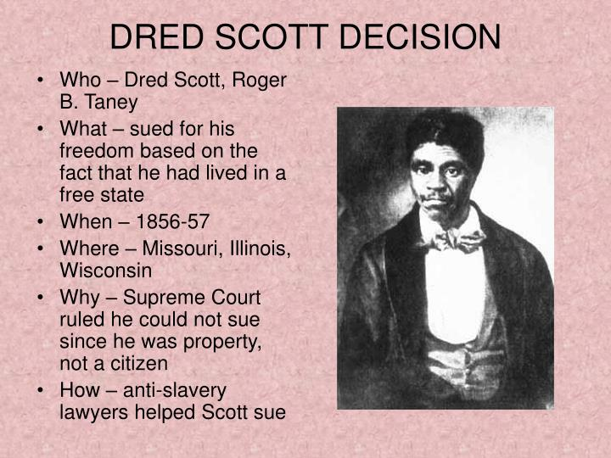
What was the Dred Scott decision of 1857?
Dred Scott was still a slave, regardless of where his owner took him. SIGNIFICANCE: The Dred Scott decision effectively ended the Missouri Compromise, hardening the political rivalry between North and South and paving the way for the Civil War.

Slide 48
What was the Dred Scott decision of 1857?
America’s Timeline
How did the Dred Scott decision occur?
  Was Democratic-controlled US Supreme Court observed that blacks “had no rights which a white man was bound to respect and that the Negro might justly and lawfully be reduced to slavery for his benefit.
  Non-Democrat Justice Benjamin R. Curtis, 1 of only 2 on the Court dissented this opinion, and provided historical information that blacks exercised the rights of citizens since the American Revolution had begun.
1860: Democrat Platform defended slavery and endorsed The Fugitive Slave Law and Dred Scott Decision.
Side Note: To this day, Republicans and Democrats to amend their platform. It is important to pay attention.
  David Barton of Wallbuilders does assist in writing these platforms.
  Democrat Party has removed “God” from their platform in present time.

Slide 49
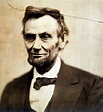
Abraham Lincoln is elected to office
1861: Abraham Lincoln is elected as first Republican President.
  Do you remember who influenced Abraham Lincoln?
    John Quincy Adams “Duty is ours, results are God’s.”

Slide 50
America’s Timeline Continued
Once Lincoln is elected to office, pro-slavery Democrats left the Union and went South and formed The Confederation of the United States.
1862: Lincoln abolished slavery in Washington, D.C.
1863: Emancipation Proclamation was issued freeing slaves in the southern states that were not freed already.
1864: Lincoln continues to sign civil rights bills.
1865: Civil War ended. The Republican Congress passes the 13th Amendment ending slavery and the 14th Amendment providing full civil rights for all blacks.

Slide 51
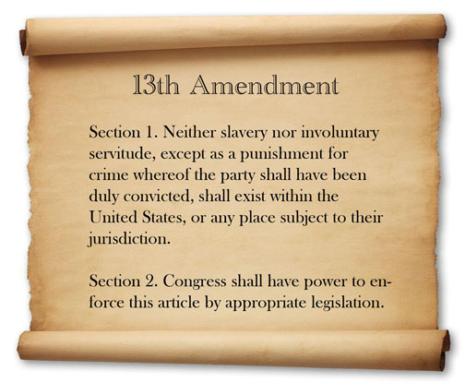
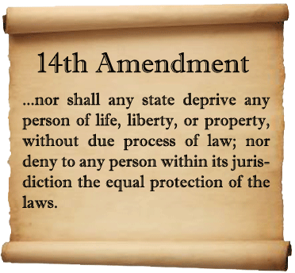

Slide 52
America’s Timeline Continued
Southern states ignored these amendments.
Those in the south, were deemed “rebels” by the Constitution under Article 1, Section 9, Clause 2. Most of these rebels were Democrat and so the South gained much Republican ground which led up to many blacks getting elected to office.
Since the rebels could not vote, they found other ways to intimidate blacks: The KKK was established by the Democrats in 1865-1866 to overthrow Republicans.
1870: 15th Amendment Passed

Slide 53
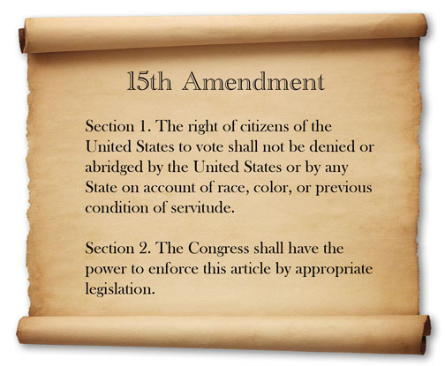

Slide 54
America’s Timeline Continued
1865-1875: Republicans passed four federal civil rights bill to protect blacks.
1876: Democrats gained control of the legislature in the southern states so repealing great bills for the black civil rights occurred.
When trying to pass the 14th and 15th Amendments, these are the road blocks Democrats implemented to make it difficult for blacks to vote: poll taxes, literacy tests, gerrymandering, white-only primaries, etc.
1900: Democrat US Sen. Tillman of SC declared, “We made up our minds that the 14th and 15th amendments are null and void; that oaths required by such laws are null and void.”
1940’s: only 5% of blacks were registered to vote in the south.
1940’s, 1950’s, 1960’s: Democrat leaders like POTUS Harry S. Truman opposed their parties’ viewpoints; however, the rank-and-file Democrats would surge.
  The rank-and-file Democrats were so bad that in 1924 when Texas Democrat Candidate for Governor, Ma Ferguson ran against Democrat KKK member, it cost her the support of the WHOLE Democrat Party in Texas.

Slide 55
America’s Timeline Continued
1954: Brown v. Board of Education happened: ending segregation in public schools.
1957: Republican Eisenhower made bold civil rights attempts; congress was in the hands of Democrats so any attempts would fail.
1963: Democrat JFK had a strong civil rights bill following the Birmingham riots. This bill would take language from Republican Eisenhower.
1964: 24th Amendment passed: abolishing the poll tax. This is why most black people today vote Democrat.

Slide 56
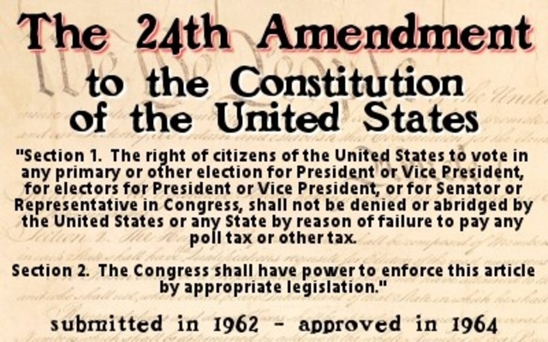

Slide 57
Truth!
I have said much about the Democrat Party.
Republicans play their part in evil too. Bush # 1 got us in to the New World Order. Local Republicans have passed Medicaid Expansion which pays for abortions and transgender reassignment in MT.
We must remember the heart of man is evil.
We must remember America’s was founded on the following: Isaiah 33:22 (three branches of government); Jeremiah 17:9 (to not follow the heart); Exodus 18:21.
All representatives should be held to these standards.
See Exhibit A: Black History Issue 2003.

Slide 58
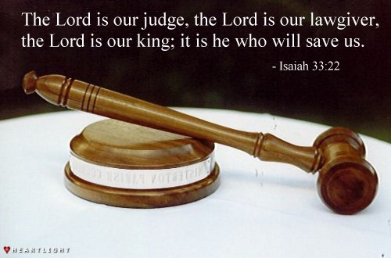

Slide 59
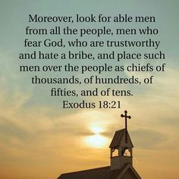
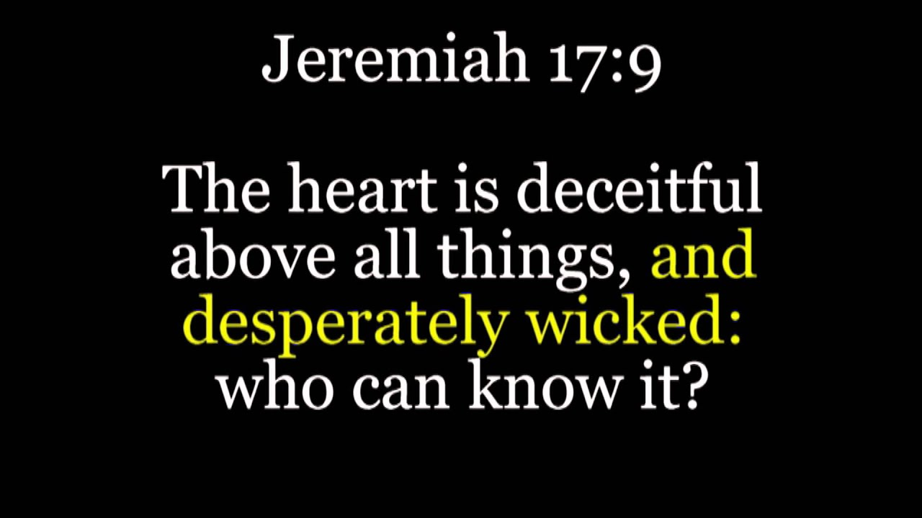

Slide 60

Some Great Black Patriots and Heroes!
Most of us have probably heard of Frederick Douglass, Harriet Tubman or George Washington Carver. Lets look at some great some great black patriots and heroes.
Wentworth Cheswell: 1745 to 1817: first black elected to office in 1768 in New Hampshire and was reelected for the next 49 years in different political offices. See Exhibit B: A Black Patriot: Wentworth Cheswell.
Thomas Hercules, elected to public office in 1793 – Pennsylvania.

Slide 61
Some Great Black Patriots and Heroes!
Lemuel Haynes: 1753-1833: A soldier in the War for American Independence; first black to have a sermon published and to receive a postgraduate degree. Started multiple churches and often pastored white congregations, and on George Washington’s birthday he would preach a sermon about his former Commander-in-Chief.
  For more info on Lemuel Haynes go to: https://wallbuilders.com/lemuel-haynes-signed-common-place-book/

Slide 62

Some Great Black Patriots and Heroes!
Harry Hoosier: 1750-1806: Founding Era preacher from whom Indiana takes its name “Hoosiers”.

Slide 63
Some Great Black Patriots and Heroes!
Black military heroes from the War for Independence: Peter Salem, Prince Estabrook, James Armistead, Prince Sisson, Prince Whipple and more!
John Marrant: 1755 – 1791: child prodigy musician and the first black American to successfully evangelize the Native Americans.
Benjamin Banneker: 1731-1806: appointed by POTUS Thomas Jefferson as a surveyor to lay out Washington, DC; mathematician who produced the first American scientific almanac.
William Nell: 1816 -1874: historian, author, was the first black to hold a position in federal office in 1861.

Slide 64
Some Great Black Patriots and Heroes!
Roberts Smalls: 1839-1915: former slave who became a Union naval ship captain in The Civil War; military Major General in SC, US Congressman.
John Rock: 1825-1866: the first black to be admitted to the US Supreme Court Bar in 1865; was a teacher, doctor and dentist.
Henry Highland Garnett: 1815-1882: first black to speak in the US House of Representatives in 1865.

Slide 65
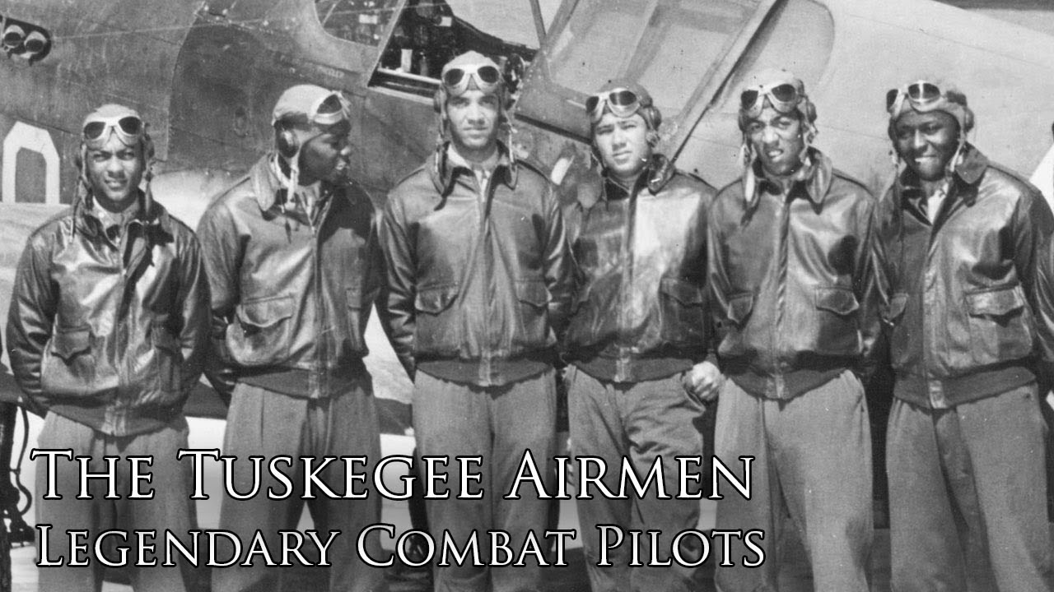
Some Great Black Patriots and Heroes!
The Tuskagee Airmen – The First Black Airmen of WWII. Who were bomber and fighter pilots!

Slide 66
Where do we go from here?
Recognize that improving and building relationships between cultures will take trust and time. Trust must be earned.
Lets build relationships with each other. We work together. We are trying to raise our families together. We worship together.
Sincerely listen to each others’ grievances or viewpoints.
“Win the person, not the argument”. – Brian Shepherd.
Ask God if to reveal to you if you have racism in your heart. If so, repent, change your ways, and move forward.

Slide 67
Where do we go from here?
Stand together with each other in every facet of life. Our cultures and ethnicities will bring about items we may not care for. Learn to deal with it. Just because we live together in a nation, does not mean we cave on our morals.
Be respectful of each other’s culture. Don’t promote or put up with crude jokes. Eventually, those “jokes” will imbed in your heart and spirit and could take sprout.
Promote policy and good principles in the Church, the family, the community, the organizations that you are involved in.
  Speak truth in all these areas.
  Write the history books if your child comes home with omitted information.
  Planned Parenthood. Why was it formed?
    Why aren’t we are promoting more policy against this?
    Did you know the founder, Margaret Sanger actually spoke to the KKK.

Slide 68
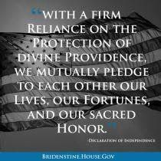
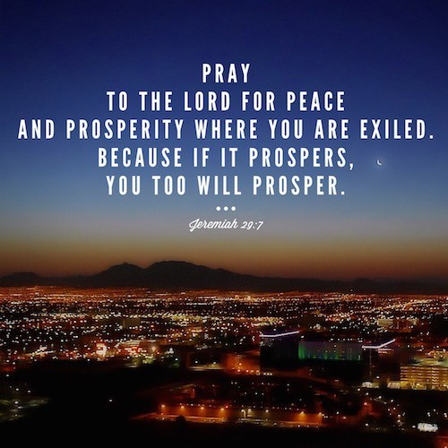
Where do we go from here?
"Stand your ground. Don't fire unless fired upon, but if they mean to have a war let it begin here."
Captain John Parker, to his Minute Men on Lexington Green, April 19, 1775.

Slide 69
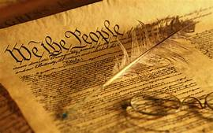
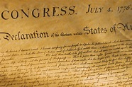
Where do we go from here?
Vote and get involved.
Read the founding documents for yourself and teach them to those around you.
Live out your freedoms, and defend your liberty.

Slide 70
Credits
Created by: Marcia A. Lennick
Exhibits are courtesy of Wallbuilders.com. Used with permission.
Please let me know if you want a copy of this information sent via email.
www.wallbuilders.com
www.wallbuilderslive.com
www.rickgreen.com
www.patriotacademy.com

