Slide 1
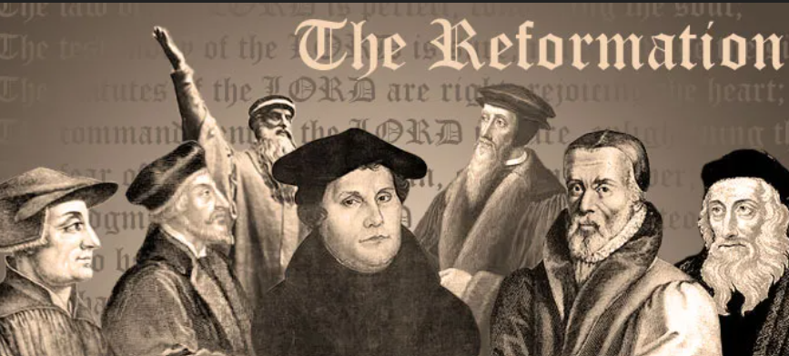
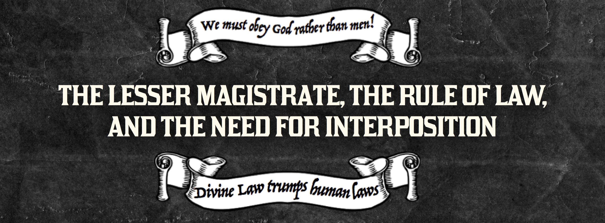
A CRASH COURSE ON THE PROTESTANT REFORMATION AND THE DOCTRINE OF LESSER MAGISTRATES

Slide 2
A CRASH COURSE ON THE PROTESTANT REFORMATION AND THE DOCTRINE OF LESSER MAGISTRATES
Every year, many celebrate Halloween. Why don't we take the time to celebrate the Protestant Reformation? After all, 10/31/1517, the 95 Thesis were nailed by Luther. Did you know the Reformation almost failed 30 years later, but a little town of Magdeburg instituted the Doctrine of Lesser Magistrates.... the lower magistrates told the higher magistrates they were in the wrong and the lower magistrates stood their ground! Once again history proves "Rebellion to Tyrants is Obedience to God".

Slide 3
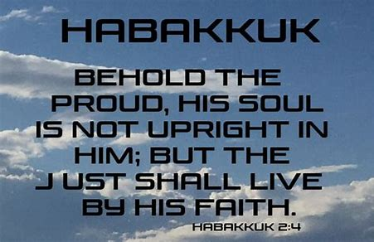

Slide 4
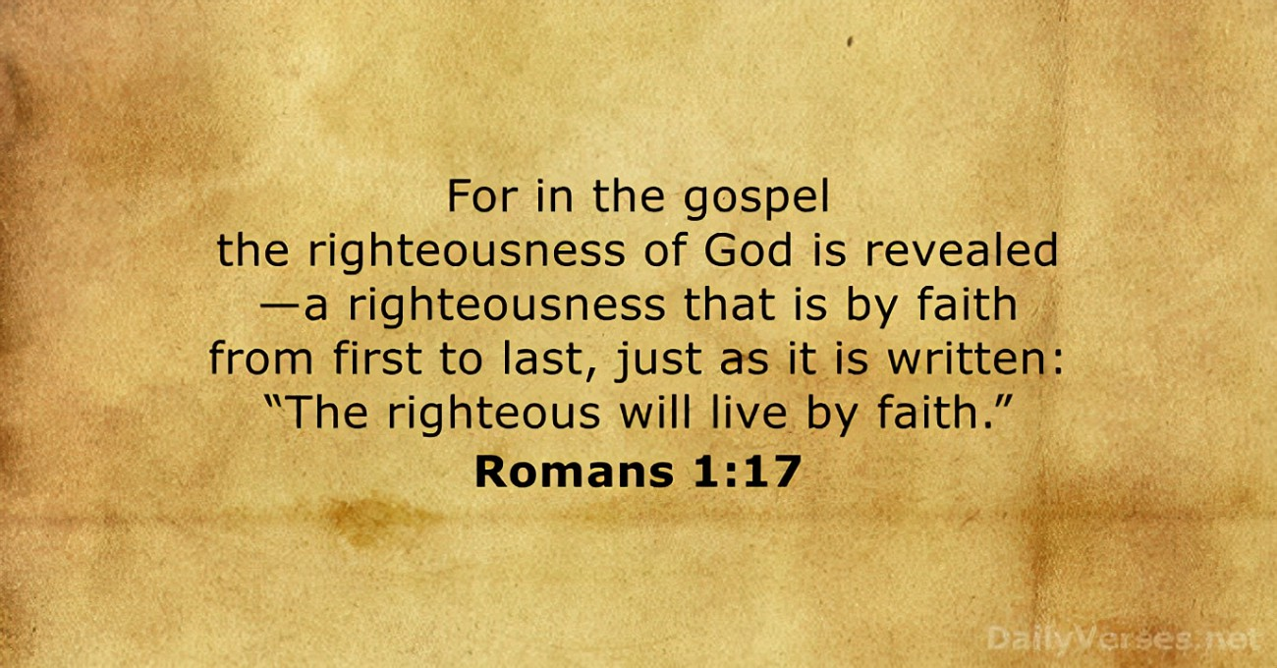

Slide 5
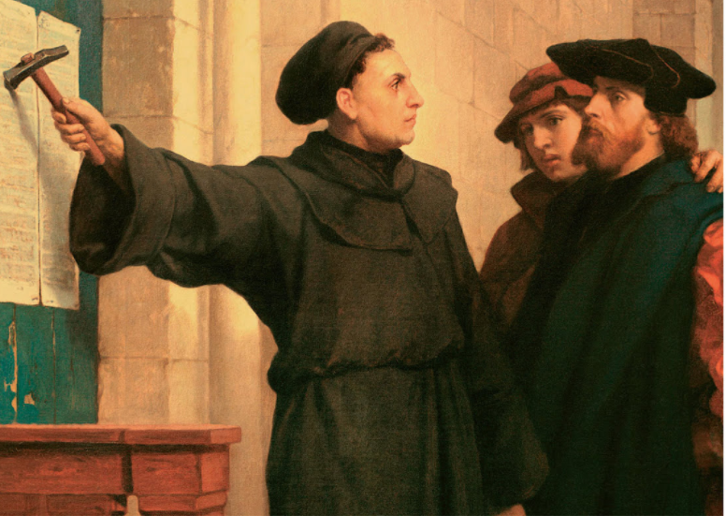
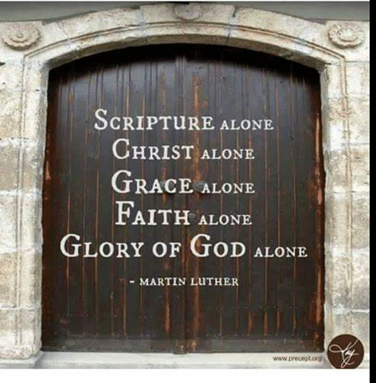

Slide 6


Join Kirk Cameron around the campfire as he guides you through The American Covenant: The Untold Story, the book that millions of people studied while gathered virtually in Kirk’s backyard, starting the movement now known as the American Campfire Revival. Now in quick video lessons designed for group discussion, Kirk is joined around the fire by author Marshall Foster, and together, they will guide you through the miraculous beginnings of America, revealing its life-giving secrets and forgotten covenants, while setting a road map for today to defeat the darkness and stir a passion for liberty! 5 week class. The information on the next few pages is a summary from this class. Go to www.constitutioncoach.com today to find a class.

Slide 7
THE PROTESTANT REFORMATION
-1381: SEEDS OF THE REFORMATION WERE PLANTED BY JOHN WyCLIFFE. HE TRANSLATED THE BIBLE FROM LATIN TO ENGLISH
-1436: GUTENBERG PRINTING PRESS INVENTED WHICH WOULD GET THE BIBLE IN THE HANDS OF THE PEOPLE, WHICH WOULD SET THE REFORMATION ABLAZE.
-1492-COLUMBUS SAILS THE OCEAN BLUE
-1517: LUTHER POSTS HIS 95 THESIS
-1525: TYNDALE TRANSLATED THE NEW TESTAMENT FROM GERMANY TO THE ENGLISH OF HIS DAY
-1538 – 1541: KING HENRY THE VIII DISTRIBUTES THE BIBLE AND AT THE SAME TIME LUTHER, CALVIN ZWINGLI AND OTHERS ARE COMING TO THE RISE. WITH THEIR RISE, THEY EXPLAIN IT IS OKAY TO RESIST TYRANNY, WHICH PLANTED THE SEEDS FOR THE PILGRIMS. THE PILGRIMMS WERE KNOWN AS THE SEPARTISTS.

Slide 8
THE PROTESTANT REFORMATION
-1550: THE MAGDEBURG CONFESSION OCCURS – THE FIRST TIME IN WORLD HISTORY WE SEE THE DOCRINE OF LESSER MAGISTRATES.
-1599: GENEVA BIBLE IS CREATED
-1603: KING JAMES TAKES THE THRONE AND WANTS TO KILL PEOPLE AND THE PILGRIMS FLEE TO HOLLAND
-1611: KJV BIBL IS CREATED
-1620: PILGRIMS (SEPARTISTS) LAND WITH THEIR OWN BIBLE (THE GENEVA BIBLE)
-1630: PURITANS ARRIVE IN AMERICA
-I WOULD RECOMMEND THE MOVIE “MONUMENTAL” BY KIRK CAMERON AS HE BREAKS DOWN THE PASTORS OF PILGRIMS

Slide 9
THE PROTESTANT REFORMATION
-1703- THE FAMOUS JONATHAN EDWARDS IS BORN
-1741- THE FAMOUS SERMON TO START THE FIRST GREAT AWAKENING “THE SINNER IN
THE HAND’S OF AN ANGRY GOD” IS PREACHED BY JONATHAN EDWARDS. OTHER GREAT PASTORS TO LOOK UP: JOHN ROBINSON, THOMAS HOOKER, PASTOR JONATHAN MAYHEW, WHITEFIELD, FREDERICK DOUGLASS, JOHN WISE, JONAS CLARK, MUHLENBERG BROTHERS.
-1770’S BOSTON MASSACRE HAPPENS (SOME HISTORIANS POINT TO THIS BEING THE START OF THE AMERICAN REVOLUIONARY WAR), INDEPENDENCE DAY, CONSTITUITON RATIFIED, BILL OF RIGHTS RATIFIED, THE FIRST WAR ON TERROR HAPPENING – TRIPOLI (1805)
-THE SEEDS THE PILGRIMS PLANTED WOULD CONTINUE ON AS IN 1806, THE HAYSTACK PRAYER MEETING WOULD OCCUR, WHICH WAS THE BEGINNING OF THE MODERN MISSIONARY MOVEMENT IN AMERICA.

Slide 10

BY: PASTOR TREWHELLA
Many Americans seem to know that America's founders gave us three boxes through which we can resist tyranny, namely - the ballot box, the jury box, and the cartridge box. But a lesser-known tool which the founders themselves employed is the lesser-magistrate doctrine.
Simply put, the lesser-magistrate doctrine declares that - when a magistrate, who is lower in authority than another higher authority, opposes and/or resists the unjust orders or laws of the higher authority, he is justified in doing so and his actions are morally right, proper, and legitimate (emphasis supplied).

Slide 11
BY: PASTOR TREWHELLA
For example, if Congress or the President makes an unjust or immoral edict, a state legislature or the governor could stand in defiance of their unjust edict and refuse to obey or implement it. They could in fact actively oppose it. Or for that matter, a city council or mayor could act in defiance or opposition of an unjust edict by a higher authority.
The lesser-magistrate doctrine became important to Christian men during the Reformation, though it had been spoken of and practiced prior to that by Christians. For example, the Magna Carta was written by a group of barons (lesser-magistrates) who had the tyrant King John of England sign it in the year 1215 at Runneymede, which is located southwest of London

Slide 12
BY: PASTOR TREWHELLA
This great document which stands in defiance of tyranny and oppression by making clear that the State has limitations and that all are subject to the law – people and state officials alike - was penned by Christian men.
Calvin spoke of the lesser-magistrate doctrine in his Institutes of the Christian Religion. Amazingly, he did not appeal to Scripture in his support of it, rather he appealed to pagan historical examples. But other Reformers did give a Scriptural foundation to the doctrine.

Slide 13
BY: PASTOR TREWHELLA
John Knox for example, in his Appellation written to the nobles of Scotland in 1558, cites many passages to support the doctrine. Knox wrote his appellation (appeal) to the nobles because the Roman church had condemned him and burned him in effigy. He wrote to declare to the nobles, as lesser-magistrates, their responsibility in protecting the innocent and opposing those who had made unjust decrees.
Knox makes it clear that it is the duty of lesser-magistrates to resist the tyranny of chief magistrates when the chief magistrate exceeds his God-given authority or actually makes declarations which are in rebellion to the law of God. (emphasis supplied).

Slide 14
BY: PASTOR TREWHELLA
He exhorts the nobles (lesser-magistrates) in his Appellation, "You are bound to correct and repress whatsoever you know him (the higher magistrate) to attempt expressly repugning to God's word, honor, glory, or what you shall espy him to do against his subjects great or small." Some of the Scripture texts Knox cites to expound on the lesser-magistrate doctrine are Daniel 3; I Kings 12; II Kings 11; and Jeremiah 26:10-16; 36:9-31; 37:11- 21 & 39:7-10.
The lesser-magistrate doctrine had a huge impact upon the thinking of our founders, and upon our nation's people regarding government and law. We however live in the midst of a statist, slave-like people where such thinking has long been forgotten. The magistrates themselves know nothing of this doctrine today because the pulpits have long been silent regarding it. (Emphasis supplied.)

Slide 15
BY: PASTOR TREWHELLA
He exhorts the nobles (lesser-magistrates) in his Appellation, "You are bound to correct and repress whatsoever you know him (the higher magistrate) to attempt expressly repugning to God's word, honor, glory, or what you shall espy him to do against his subjects great or small." Some of the Scripture texts Knox cites to expound on the lesser-magistrate doctrine are Daniel 3; I Kings 12; II Kings 11; and Jeremiah 26:10-16; 36:9-31; 37:11- 21 & 39:7-10.
The lesser-magistrate doctrine had a huge impact upon the thinking of our founders, and upon our nation's people regarding government and law. We however live in the midst of a statist, slave-like people where such thinking has long been forgotten. The magistrates themselves know nothing of this doctrine today because the pulpits have long been silent regarding it. (Emphasis supplied.)

Slide 16
BY: PASTOR TREWHELLA
If ever this nation needs to understand the lesser-magistrate doctrine, it is now. Immoral and unjust edicts are commonplace. The preborn are being murdered, and sodomy is being proliferated.
The assault upon our freedom and liberties is a daily undertaking by those in high office. The attacks upon the law of God are ferocious and relentless. In our nation today, the State has declared good to be evil and evil to be good. The lesser-magistrate has a duty before God to uphold the good regardless of the new definitions created by the State. (Emphasis supplied.)

Slide 17
BY: PASTOR TREWHELLA
We must remember that all authority is delegated. No man who holds State office rules autonomously. The authority he has is delegated to him by God. Hence, all those in positions of authority stand accountable to God. This is why the practice of the church historically has been – when the State commands that which God forbids or forbids that which God commands, we have a duty to obey God rather than man. The Bible clearly teaches this principle.
The lesser-magistrate is to apply this principle to his office as magistrate. When an unjust edict is made by a higher authority, the lesser-magistrate must choose to either join the higher magistrate in his rebellion against God, or stand with God in opposition to the unjust edict.
As our nation sinks more and more into rebellion and depravity, the lesser-magistrate doctrine needs to be taught more than ever. May the Lord grant us the strength and favor to do so.

Slide 18
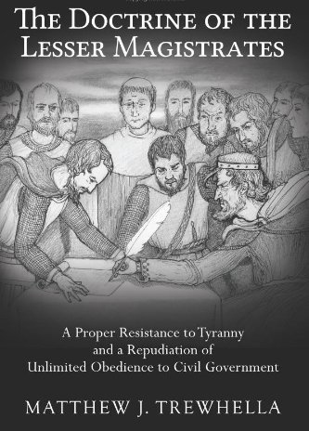

Slide 19
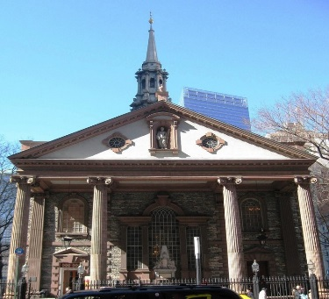
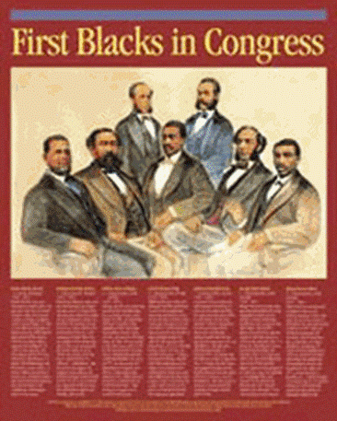
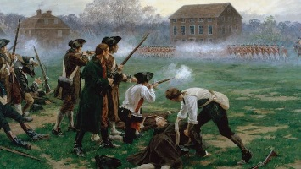
History Presentations by: Marcia A. Lennick
America’s Unknown Known History: Where we dive in to what was once taught in American Education. You will get to see replicas of school books. Learn more about the truth behind Separation of Church and State, why did Thomas Jefferson have a Quran? Are we a Christian Nation? How and why did we get In God We Trust as our National Motto? And more! Two night class.
Black History: Come learn about some of America’s black patriots. Learn about
the 3/5 Clause in the Constitution. Why didn’t we abolish slavery in our founding?
Did the Bible permit slavery? And more. Two night class
Revisiting “The Shot Heard Around the World”: Come visit the Hancock/Clark House. Learn more about Reverend Clark whose words were known to be
“the primer in the guns” that prepared the Minutemen for The Battle of
Lexington and Concord. You will get a copy of the sermon he preached
one year after the shot! One night class.

Slide 20
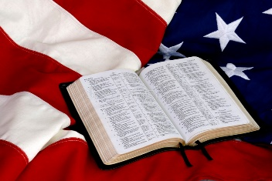
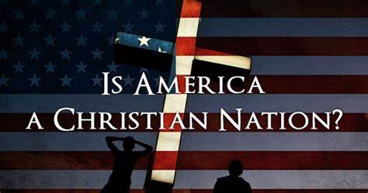
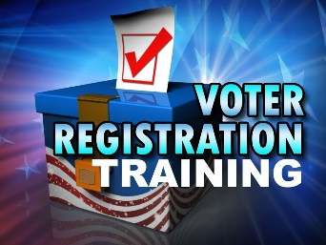
History Presentations by: Marcia A. Lennick
The Influence of the Bible in America: Were the Founding Fathers agnostics and deists, or did their faith have something to do with creating the greatest country on earth? Come and learn how the Bible influenced Civil Law, what our Founding Fathers thought of the Bible, and how the Bible is woven in to every part of the American culture. One night class.
Is America a Christian Nation?: I was the attorney and put the evidence on trial, and you became the judge and the jurors to see if America was founded on Christian principles. Click on the link below. One night class.
Voter Registration Drive for Churches: Come and learn the history the church played in America, the Black Robed Regiment, The Doctrine of Lesser Magistrates, legal do’s and don’ts for churches to host a voter registration booth in your church. One night class.

Slide 21

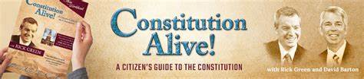
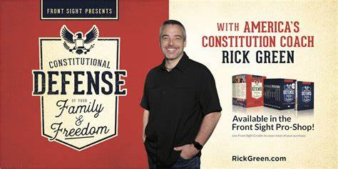
Now more than ever, our nation is in need of Biblical citizens who grasp the dynamic unity of citizens of the Kingdom of God and citizens of this great nation!
This course offers the quick-start guide to the longest standing Constitution in history, complete with an overview of all the Articles, and Amendments. What sets this apart from other U.S. Constitution courses is the interactive, fast-paced presentations; the fabulous locations of Independence Hall and the Wallbuilders' Library; and finally our Biblical heritage is intricately woven throughout the entire course!
You will learn how the founders relied on their Christian moorings and Biblical worldview to secure the blessings of liberty to ourselves and our posterity. You will also be treated to encouraging historical facts and inspirational true stories that are not taught in our educational institutions today. All in all, you will be edified and equipped to operationalize your faith and practice Biblical Citizenship in Modern America!
Depending on what program you select, these classes, last from 6-8 weeks, 2 hour classes.

Slide 22
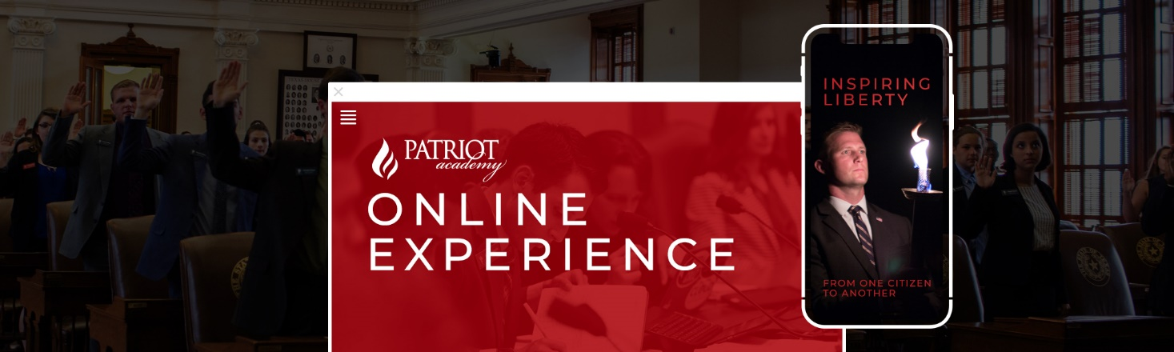
From anywhere in the world, you can stream the Patriot Academy (PA) Online Experience, world-class leadership training specializing in applied civics with a Biblical, historical, and Constitutional foundation. PA students develop leadership skills with an emphasis on character, courage, life purpose, and personal skills, underpinned by a founding fathers’ philosophy of governance.
We are the premier political leadership training ground in the nation, with the most realistic simulated-legislative session available. Join us for this entertaining, educational, and inspirational experience. This class is yet TBD.

Slide 23
Join Kirk Cameron around the campfire as he guides you through The American Covenant: The Untold Story, the book that millions of people studied while gathered virtually in Kirk’s backyard, starting the movement now known as the American Campfire Revival. Now in quick video lessons designed for group discussion, Kirk is joined around the fire by author Marshall Foster, and together, they will guide you through the miraculous beginnings of America, revealing its life-giving secrets and forgotten covenants, while setting a road map for today to defeat the darkness and stir a passion for liberty! 5 week class.

Slide 24
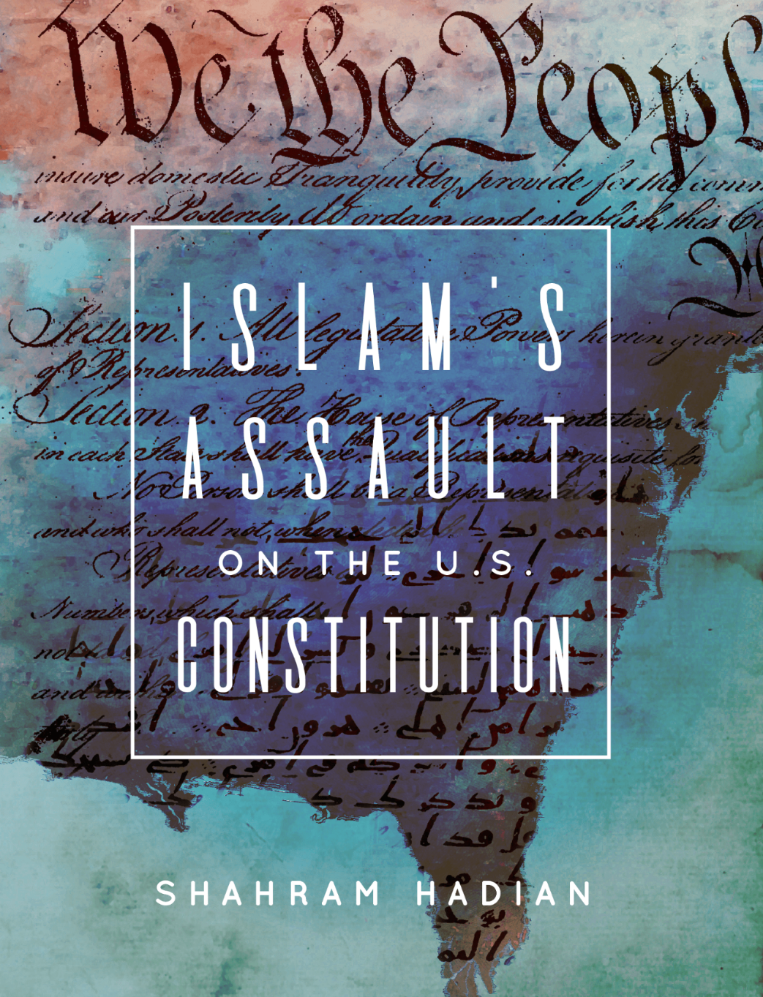
Outline America's foundational rights enshrined under our Declaration, Constitution & Bill of Rights
Reveal how Islamic law (Shari'ah) violates the 1st Amendment
Expose Islam's barbaric teachings on apostasy, women's rights, religious minorities, slavery, homosexuality, anti-Semitism & many other areas that violate protections under our Constitution
Detail the disturbing trend of US Muslims & the Muslim Brotherhood demanding Shari'ah over our Laws
Explain practical ways to protect our Constitution from Islam's growing assault
Detail how the left and liberal Christians are complicit in Islam's agenda to tear down our Constitutional foundation
Presentation by Shahram Hadian. One night class.

Slide 25
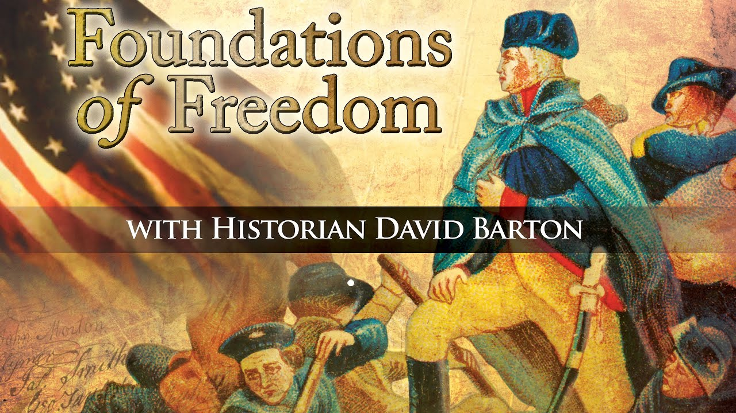
America's story is more bold, colorful, and compelling than you ever imagined! The time is now to rediscover the vision, passion, and wisdom of those who laid the foundations of our nation. Join historian David Barton with special guests Glenn Beck, Rick Green, Dr. Carol M. Swain, and Congresswoman Michele Bachmann as they explore the America our Founding Fathers envisioned. 6 week class.

Slide 26


I have most of the DVD’s from Wallbuilders and Patriot Academy.
Check out the Wallbuilders and Patriot Academy stores at www.wallbuilders.com and www.patriotacademy.com.
If a course catches your eye, let me know, and I can try to host a class!

Slide 27
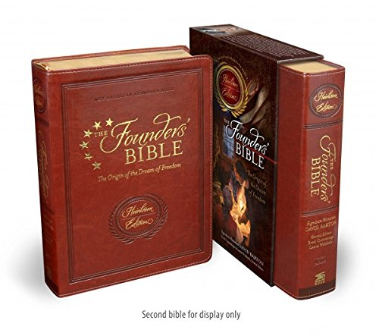
Read the Bible in a Year
Our founders would read the Bible in a year. Why don’t you give it a try? Not just the Bible – The Founder’s Bible where you will embark on the journey to dive in to the minds of our Founding Fathers and see how the Bible influenced America.
Purchase one today: www.thefoundersbible.com

Slide 28
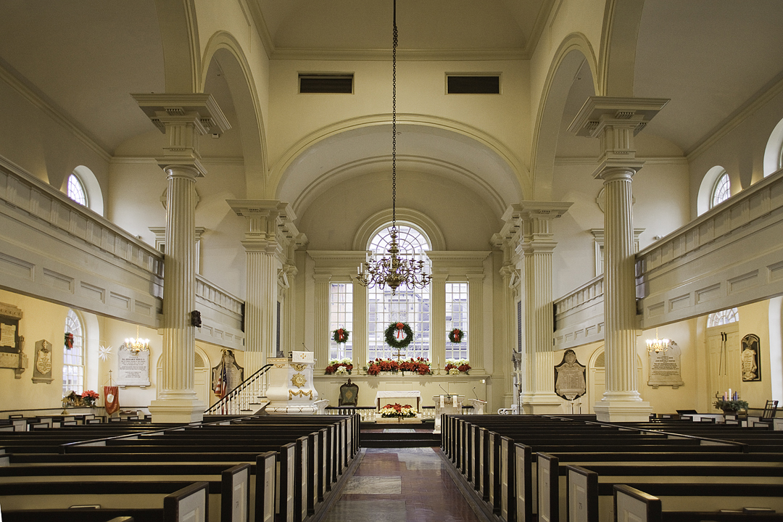
Questions for your Pastor, new Pastor, board member, or potential new board member!

Slide 29
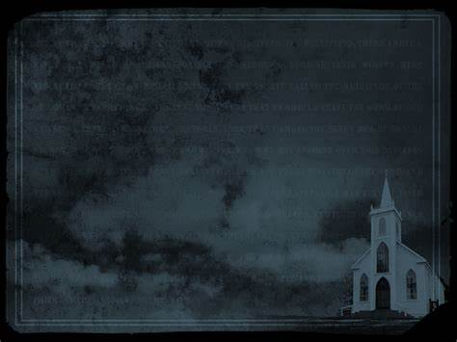
Questions to ask Pastors, new Pastors, potential church board members:
How do you define success? George Barna study showed this is how Pastors define success:
attendance, giving, number of programs, number of staff and square footage.
2) What is your view of Romans 13? Look at the Heroes of the Hall of Faith — all of them defied government.
Revelation 21:8 clearly states the cowards will not inherit the Kingdom of God. Are we cowardly when we are silent?
3) If you are the Shepherd of the sheep, who are the wolves and how do you intend to protect the sheep? Should we defy government? (A good resource is Lex Rex).
4) Are you a theological conservative (actually believing the entire Bible is without error?

Slide 30
5) Do you believe the Bible speaks to all areas of life?
6) Are you willing to preach on all areas of life?
7) How do we make disciples?
8) When should we submit to government and when should we defy government? (A good resource is Lex Rex (it can be purchased here)
9) Why do we render the things unto Caesar that are God’s? Do we know what is God’s or Caesar’s?​
-From Tim Barton of Wallbuilders when asked "What do I ask a new potential Pastor as I am the search committee as my Senior Pastor is retiring"? 9/24/2022

Slide 31


Slide 32
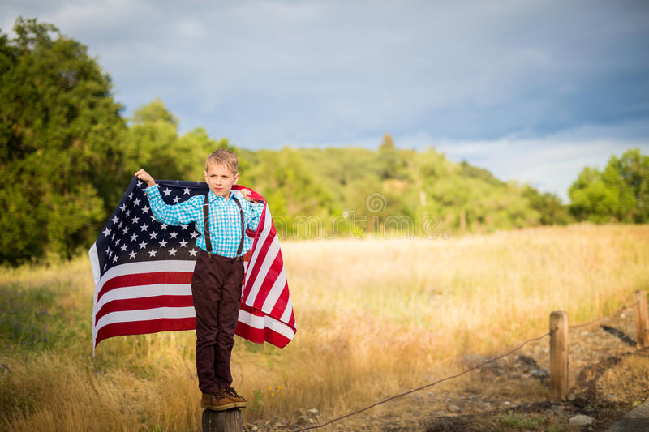
1- God must be # 1 no matter what. Make the memories. Have breakfast as a family and read the Bible.
2- Teach your kids that faith is not a burden. That going to church isn’t a chore. We get TO DO THIS. We don’t have to do this.
3- Keep perspective. God has called you hear for a time such as this.
4-Thankful heart. Read the Founders and see how they lived and impart that on your children. David Barton was impacted by a writing by Benjamin Rush that he essentially thanked God for the blessings He forget to thank God for.
5-Be intentional. Reaffirm God’s Truth in to your kids.
​
-From Tim Barton of Wallbuilders when asked "How to raise kids Patriotic"? 9/24/2022
A few questions to ask yourself: 1) can we continue down this moral decay and continue as a nation? 2) can we continue on down this path of financial debt? 3) is our hope in American politics or the God that America was founded upon? 4) can we stop Bible prophecy? 5) is America listed in Bible prophecy?

Slide 33
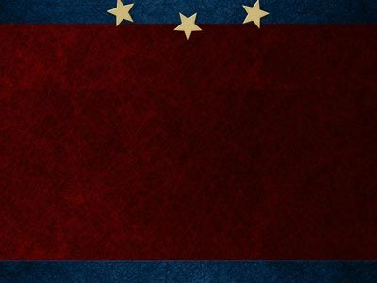

www.starsandstripes316.com

