Slide 1
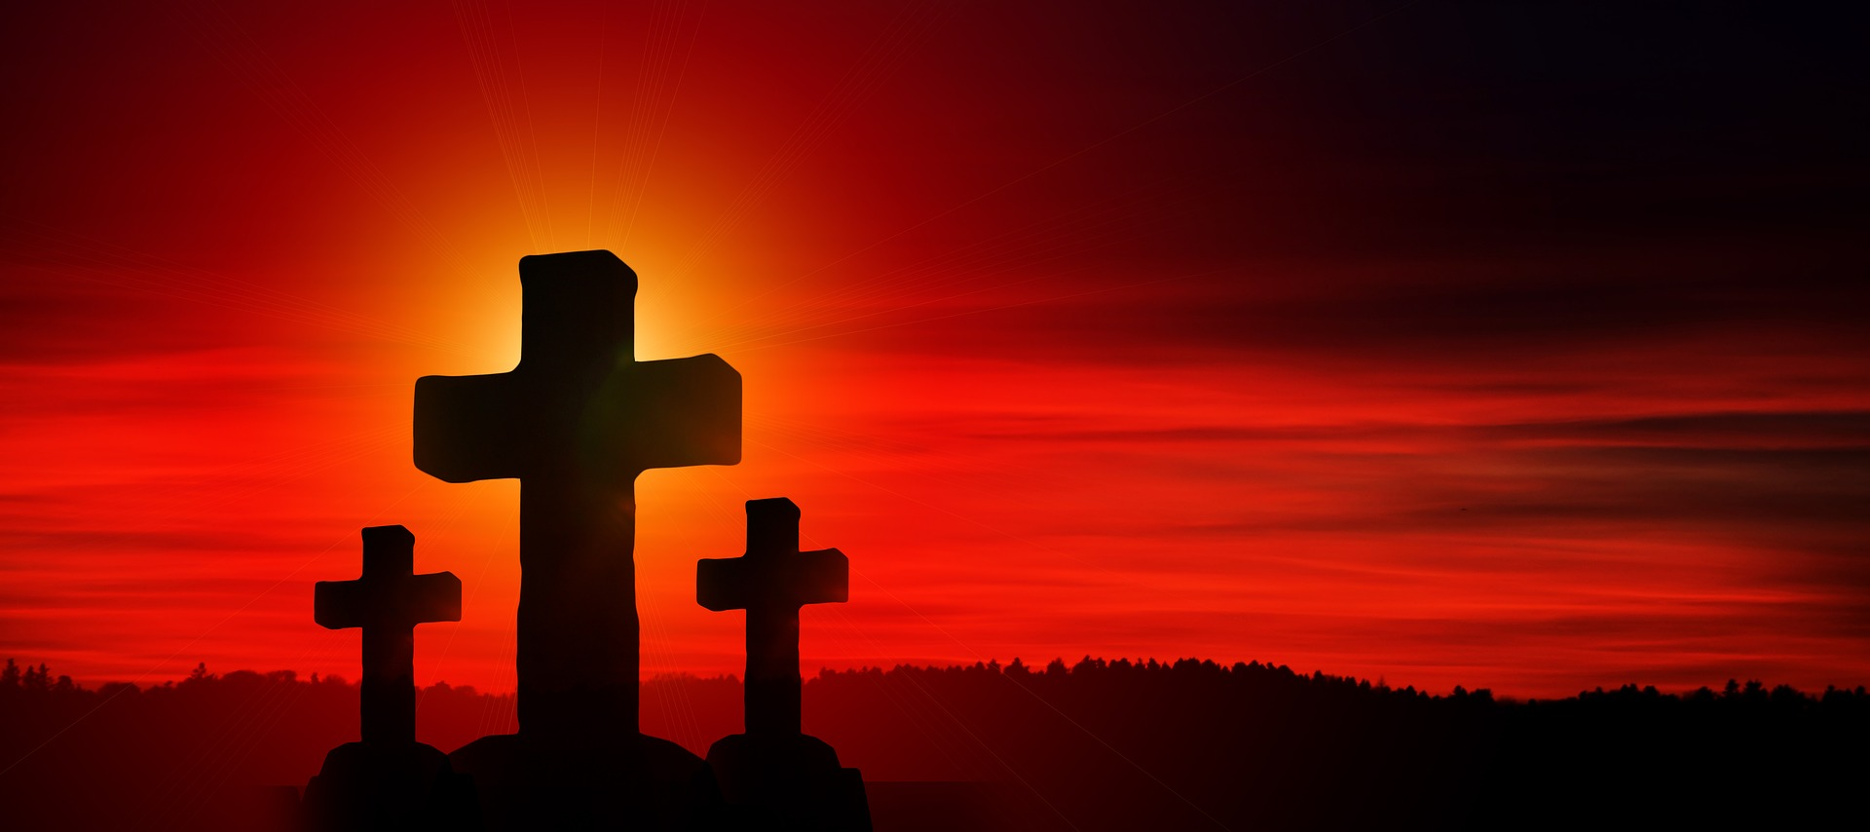

Why The Cross is the
Greatest Day in History… because History is HIS-STORY
By: Marcia A Lennick

Slide 2

Why The Cross is the
Greatest Day in History
By: Marcia A Lennick
Today is Palm Sunday
They took the branches of the palm trees and went out to meet Him, and began shouting, “Hosanna! Blessed is He who comes in the name of the Lord, indeed, the King of Israel!”
-John 12:13

Slide 3
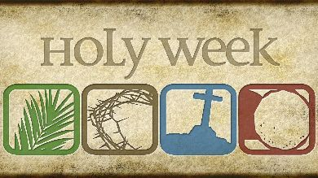
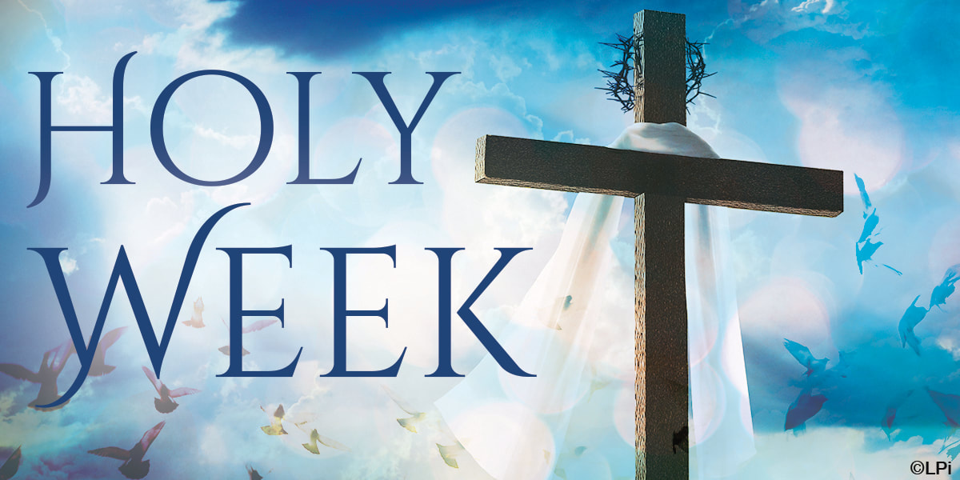
Why The Cross is the
Greatest Day in History
By: Marcia A Lennick
Today also kicks off Holy Week
They took the branches of the palm trees and went out to meet Him, and began shouting, “Hosanna! Blessed is He who comes in the name of the Lord, indeed, the King of Israel!”
-John 12:13

Slide 4
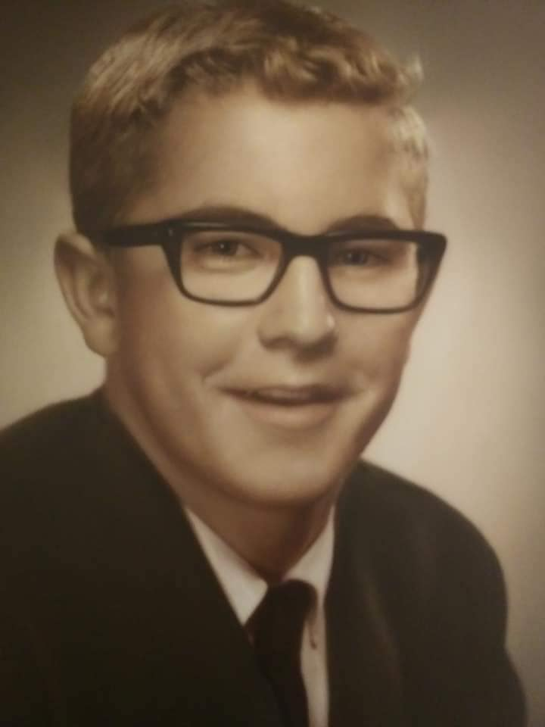

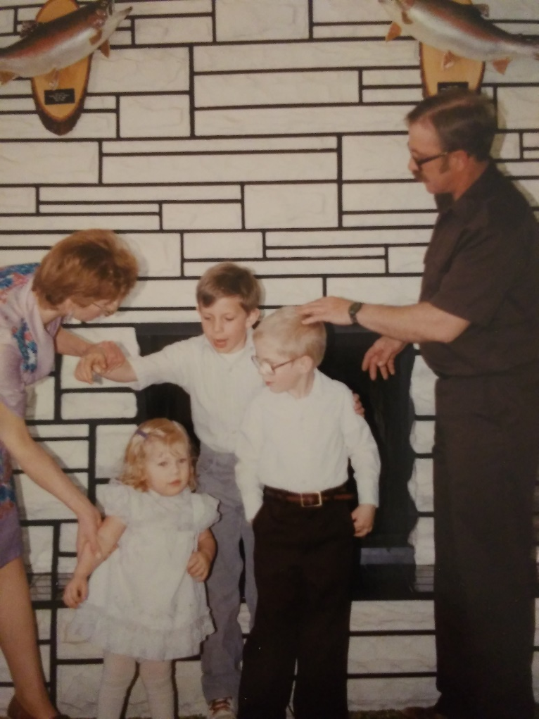
In Loving Memory

Slide 5
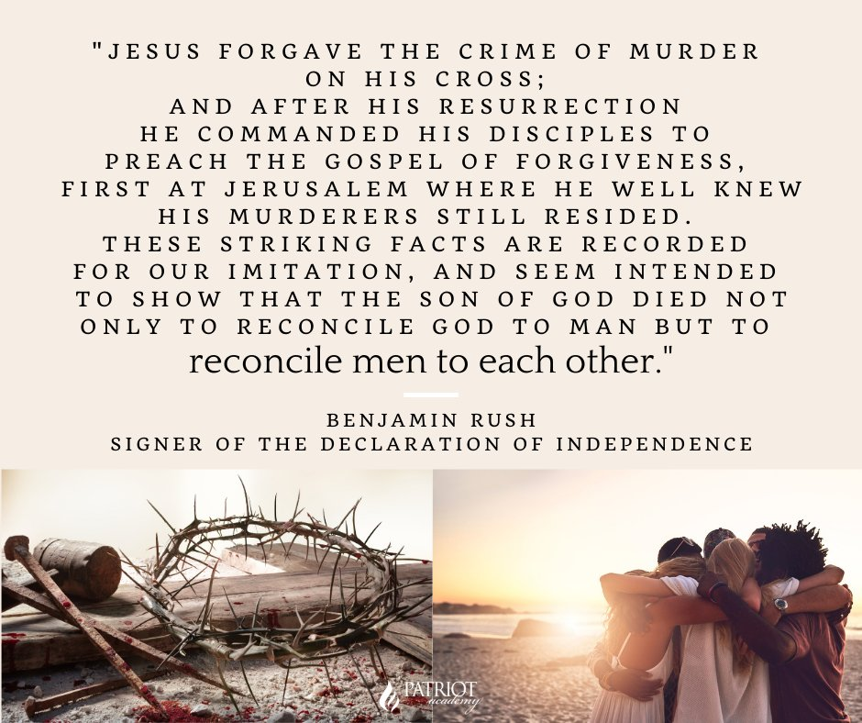
Premise of Hebrew Law
The Hebrews respected the dignity of Labor
-Proverbs 6:6, 6:9, 10:26, 13:4, 20:4, 26:16
The Hebrews placed high value on education
-Adults –their education included the public reading of the Law every 7 years – Deut 31:12- 13
-Covenant renewal enactments occurred: Deut. 29-30; Joshua 23-24
-Periodic national festivals in which Israel’s history and tradition were taught
Hebrews values liberty, and their legal instructions were designed to promote and protect liberty
-Leviticus 25:10
-In the Old Testament, Liberty had various contexts: National freedom led out by bondage by Egypt, freedom as an Independent State, freedom from servanthood in the year of Jubilee and freedom from oppressive burdens, thou shalt/thou shalt not – gave Hebrews boundaries by God of what to do or not to do

Slide 6
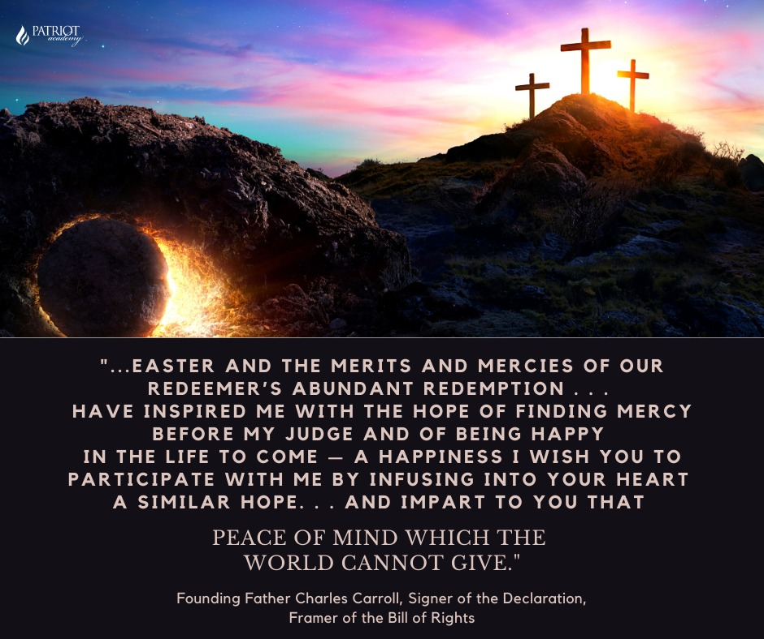
Premise of Hebrew Law
The Hebrews respected the dignity of Labor
-Proverbs 6:6, 6:9, 10:26, 13:4, 20:4, 26:16
The Hebrews placed high value on education
-Adults –their education included the public reading of the Law every 7 years – Deut 31:12- 13
-Covenant renewal enactments occurred: Deut. 29-30; Joshua 23-24
-Periodic national festivals in which Israel’s history and tradition were taught
Hebrews values liberty, and their legal instructions were designed to promote and protect liberty
-Leviticus 25:10
-In the Old Testament, Liberty had various contexts: National freedom led out by bondage by Egypt, freedom as an Independent State, freedom from servanthood in the year of Jubilee and freedom from oppressive burdens, thou shalt/thou shalt not – gave Hebrews boundaries by God of what to do or not to do

Slide 7
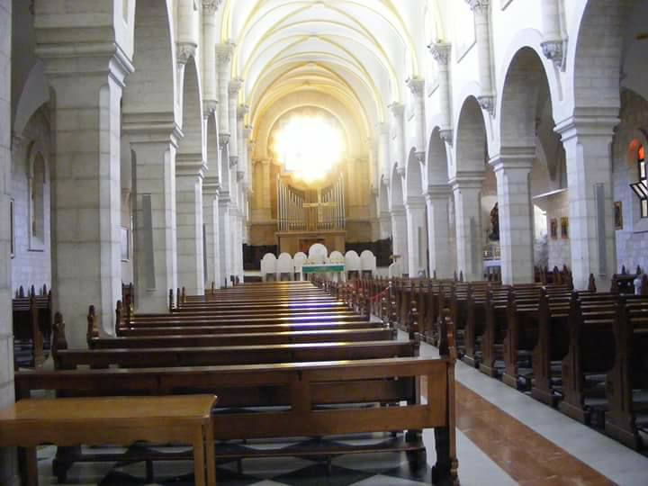
Why Study Church History?

Slide 8
So we don’t forget to remember….

Slide 9
This is a VERY historical Church – The Church of the Nativity – The Birth Place of Christ.

Slide 10
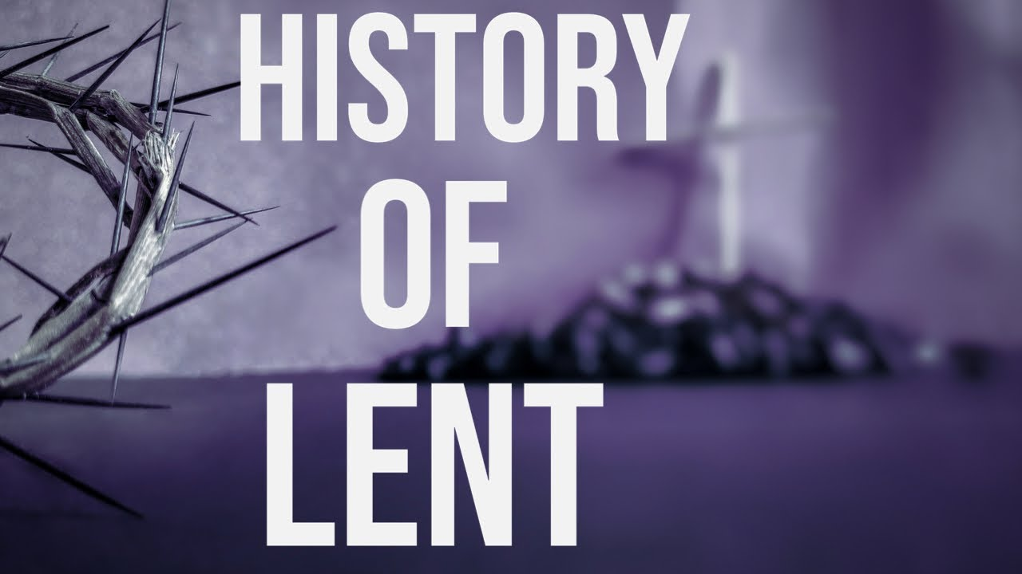
Premise of Hebrew Law
The Hebrews respected the dignity of Labor
-Proverbs 6:6, 6:9, 10:26, 13:4, 20:4, 26:16
The Hebrews placed high value on education
-Adults –their education included the public reading of the Law every 7 years – Deut 31:12- 13
-Covenant renewal enactments occurred: Deut. 29-30; Joshua 23-24
-Periodic national festivals in which Israel’s history and tradition were taught
Hebrews values liberty, and their legal instructions were designed to promote and protect liberty
-Leviticus 25:10
-In the Old Testament, Liberty had various contexts: National freedom led out by bondage by Egypt, freedom as an Independent State, freedom from servanthood in the year of Jubilee and freedom from oppressive burdens, thou shalt/thou shalt not – gave Hebrews boundaries by God of what to do or not to do

Slide 11
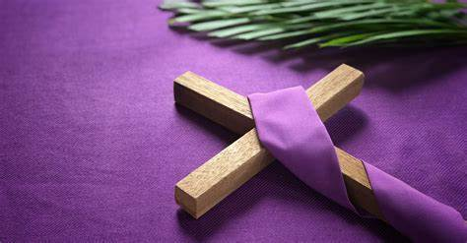
What is Lent?
Usually occurs 6 weeks to Easter. It’s a time of prayer, fasting, and preparation for Easter.
I personally LOVE how Catholics will burn the palm branches from the year before to put the Cross of Christ on their forehead for Ash Wednesday.
The reason we have Clam Chowder on Fridays.

Slide 12
Origins of Lent
Council of Nicea, AD 325.
  -This council was created to refute the claims that Christ was not divine.
  -Councils would meet to discuss doctrine, canonization of Scripture, Church protocol.
At this time the Nicene Creed would be adopted by Church councils.

Slide 13
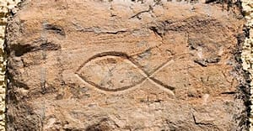
Origins of Lent
Constantine was reigning at this time and converted to Christianity and made Christianity legal.
  Prior to Constantine, Christians were under extreme persecution.
  Constantine would issue the Edict of Milan, ending persecution.
  During this time, Christians would use the Ichthus to show they were Christians.

Slide 14
Origins of Lent
St. Nicholas could have been at this church council. This would be the same St. Nicholas where we get the origins of Christmas from.
  This same Nicholas would preach against the fertility Goddess that the Paul references in Acts 19

Slide 15
Should we celebrate
Lent, Easter and
Christmas?
I would say do as your conscience says.
In American History, Christmas was actually illegal at one point.
I know people who don’t celebrate Christmas to this day!
When I see Christmas I can see the green on the trees represents eternal life and I am reminded Christ died on a Cross.

Slide 16
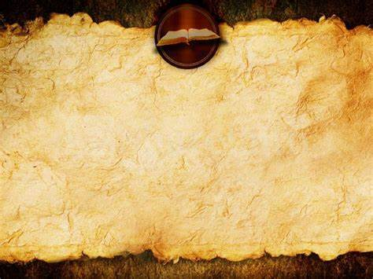
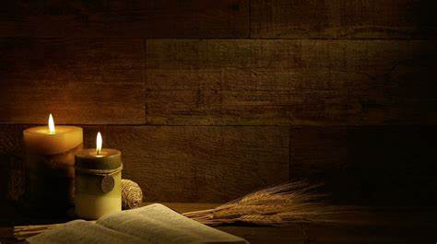
Premise of Hebrew Law
How should I study the Bible?
The Hebrews respected the dignity of Labor
-Proverbs 6:6, 6:9, 10:26, 13:4, 20:4, 26:16
The Hebrews placed high value on education
-Adults –their education included the public reading of the Law every 7 years – Deut 31:12- 13
-Covenant renewal enactments occurred: Deut. 29-30; Joshua 23-24
-Periodic national festivals in which Israel’s history and tradition were taught
Hebrews values liberty, and their legal instructions were designed to promote and protect liberty
-Leviticus 25:10
-In the Old Testament, Liberty had various contexts: National freedom led out by bondage by Egypt, freedom as an Independent State, freedom from servanthood in the year of Jubilee and freedom from oppressive burdens, thou shalt/thou shalt not – gave Hebrews boundaries by God of what to do or not to do
How should I study the Bible?
-Ask yourself what you’re reading –
-How does this passage relate to the entire chapter I’m in?
-How does this passage relate to the entire Book I’m in? What was going on at the time the Book what was written? To whom was the Book Written? By whom was the Book written to, etc.
-How does this passage relate to the entire Bible as a whole?
-If you do this, one is less likely to take Scripture out of context.
-Remember Scripture never conflicts with itself.

Slide 17
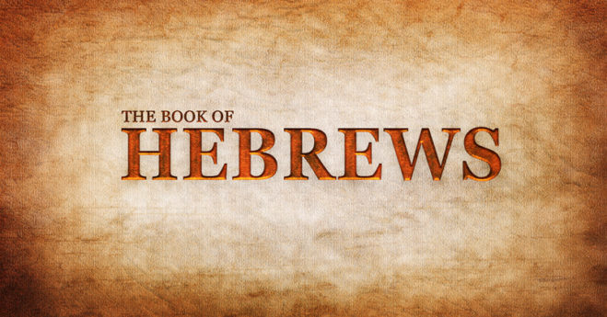

Slide 18
History behind Hebrews
-persecution was occurring as Christianity was spreading during the first century
-the purpose of The Book of Hebrews – to encourage the Jewish Believers in Christ to stay steadfast in the faith
-author unknown
-Hebrews demonstrates the supremacy and sufficiency of Jesus Christ
-better, more, great and greater appear some 45 times in this book, making Hebrews a book of superlatives about Christ
***notes on this slide taken from the David Jeremiah Study Bible***

Slide 19
History behind Hebrews
-Jesus Christ was greater and superior than the angels, Moses and the priests (Chapters 1-7)
-He is our High Priest – as He gave a better and new covenant. It was so sufficient that it would never need to be repeated (Chapters 8-10)
-B/C Jesus fulfills the OT, these Hebrew Christians were not following a new faith, but the author of perfector of the faith of their ancestors (Chapters 11-12)
-Christians need to persevere and let their lives be evidence of their faith (Chapter 13)
***notes on this slide taken from the David Jeremiah Study Bible***

Slide 20
9 Now even the first covenant had regulations for divine worship and the earthly sanctuary. ² For a ^{[a]}tabernacle was equipped, the ^{[b]}outer sanctuary, in which were the lampstand, the table, and the ^{[c]}sacred bread; this is called the Holy Place. ³ Behind the second veil there was a ^{[d]}tabernacle which is called the Most Holy Place, ⁴ having a golden ^{[e]}altar of incense and the ark of the covenant covered on all sides with gold, in which was a golden jar holding the manna, Aaron’s staff which budded, and the tablets of the covenant; ⁵ and above it were the cherubim of glory overshadowing the ^{[f]}atoning cover; but about these things we cannot now speak in detail.

Slide 21
⁶ Now when these things have been so prepared, the priests are continually entering the ^{[g]}outer ^{[h]}tabernacle, performing the divine worship, ⁷ but into the second, only the high priest enters once a year, not without taking blood which he offers for himself and for the ^{[i]}sins of the people committed in ignorance. ⁸ The Holy Spirit is signifying this, that the way into the holy place has not yet been disclosed while the ^{[j]}outer tabernacle is still standing, ⁹ which is a symbol for the present time. Accordingly both gifts and sacrifices are offered which cannot make the worshiper perfect in conscience, ¹⁰ since they relate only to food, drink, and various washings, regulations for the ^{[k]}body imposed until a time of reformation.

Slide 22
¹¹ But when Christ appeared as a high priest of the good things ^{[l]}having come, He entered through the greater and more perfect ^{[m]}tabernacle, not made by hands, that is, not of this creation; ¹² and not through the blood of goats and calves, but through His own blood, He entered the holy place once for all time, ^{[n]}having obtained eternal redemption. ¹³ For if the blood of goats and bulls, and the ^{[o]}ashes of a heifer sprinkling those who have been defiled, sanctify for the ^{[p]}cleansing of the flesh, ¹⁴ how much more will the blood of Christ, who through ^{[q]}the eternal Spirit offered Himself without blemish to God, cleanse your conscience from dead works to serve the living God?

Slide 23
¹⁵ For this reason He is the mediator of a new covenant, so that, since a death has taken place for the redemption of the violations that were committed under the first covenant, those who have been called may receive the promise of the eternal inheritance. ¹⁶ For where there is a ^{[r]}covenant, there must of necessity ^{[s]}be the death of the one who made it. ¹⁷ For a ^{[t]}covenant is valid only when people are dead, ^{[u]}for it is never in force while the one who made it lives. ¹⁸ Therefore even the first covenant was not inaugurated without blood. ¹⁹ For when every commandment had been spoken by Moses to all the people according to the Law, he took the blood of the calves and the goats, with water and scarlet wool and hyssop, and sprinkled both the book itself and all the people, ²⁰ saying, “This is the blood of the covenant which God commanded you.”

Slide 24
²¹ And in the same way he sprinkled both the ^{[v]}tabernacle and all the vessels of the ministry with the blood. ²² And almost all things are cleansed with blood, according to the Law, and without the shedding of blood there is no forgiveness.
²³ Therefore it was necessary for the copies of the things in the heavens to be cleansed with these things, but the heavenly things themselves with better sacrifices than these. ²⁴ For Christ did not enter a holy place made by hands, a mere copy of the true one, but into heaven itself, now to appear in the presence of God for us; ²⁵ nor was it that He would offer Himself often, as the high priest enters the Holy Place year by year with blood that is not his own.

Slide 25
²⁶ Otherwise, He would have needed to suffer often since the foundation of the world; but now once at the consummation of the ages He has been revealed to put away sin ^{[w]}by the sacrifice of Himself. ²⁷ And just as it is destined for people to die once, and after this comes judgment, ²⁸ so Christ also, having been offered once to bear the sins of many, will appear a second time for salvation without reference to sin, to those who eagerly await Him.

Slide 26
Cross-References
-Leviticus 16&17
-Genesis 3:21
-Exodus 12

Slide 27
Cross-References
-Leviticus 16&17
-Genesis 3:21
-Exodus 12

Slide 28
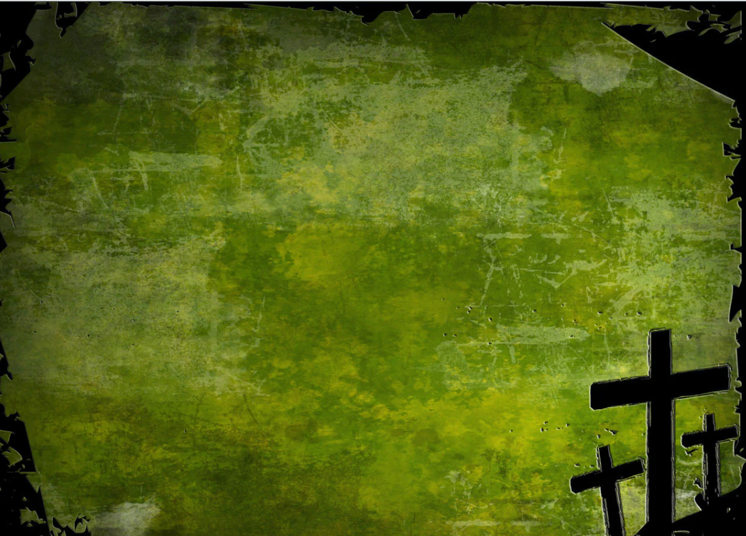

CHALLENGE FOR THE WEEK
Challenges this week-
-Look up The Stations of the Cross – there is some FUN history
-Do a spiritual inventory of where you’re at - are you growing in God?
TAKE A LEAP OF FAITH

